Slide 1
Communications Update
Tiffany Adams
NSUF Communications Lead

Slide 2
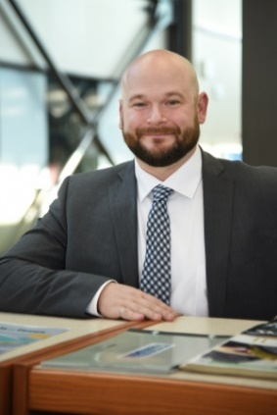
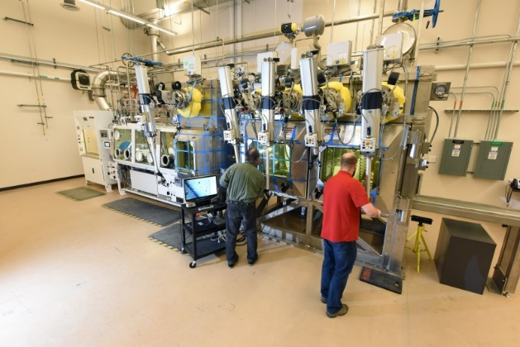
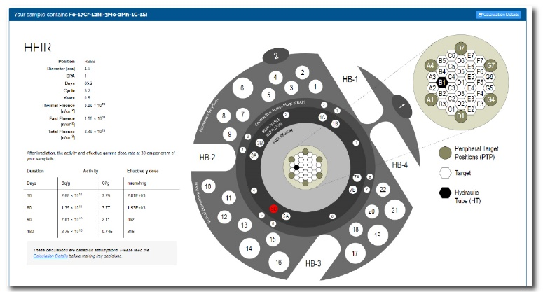
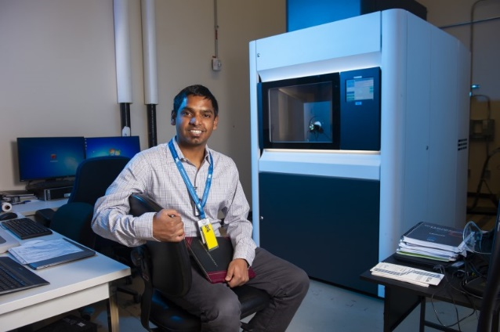
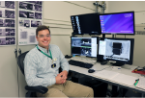
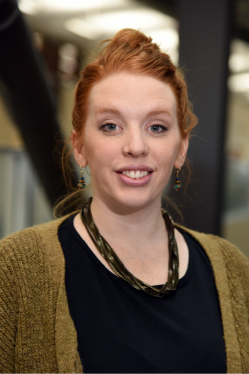
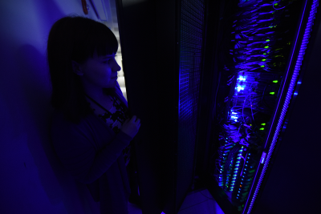
Feature Stories
RAD Calculator
NFML Updates
Students of NSUF
HPC Impacts
Researcher feature
Haiming Wen
Kaustubh Bawane
Program Office features
Jeff and Lindy
Colin Judge
Rachel Jones
Notes:
RAD Calculator highlight was also picked up by ANS and sent out via their newswire

Slide 3
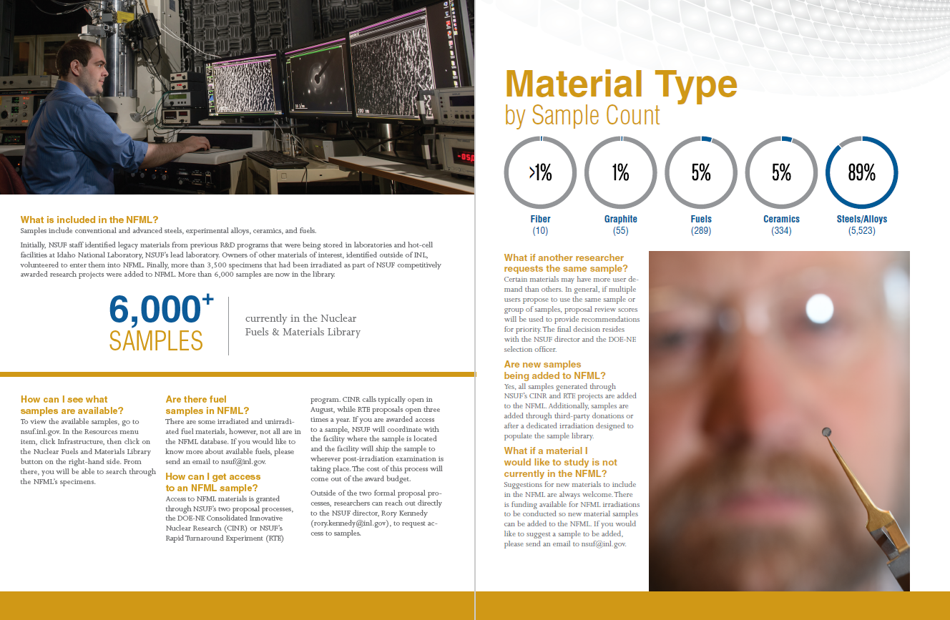
NFML Fact Sheet
Added an NFML fact sheet to use at conferences
Answers common questions about the NFML like what is included, how researchers can get access to samples, and how samples are added.

Slide 4
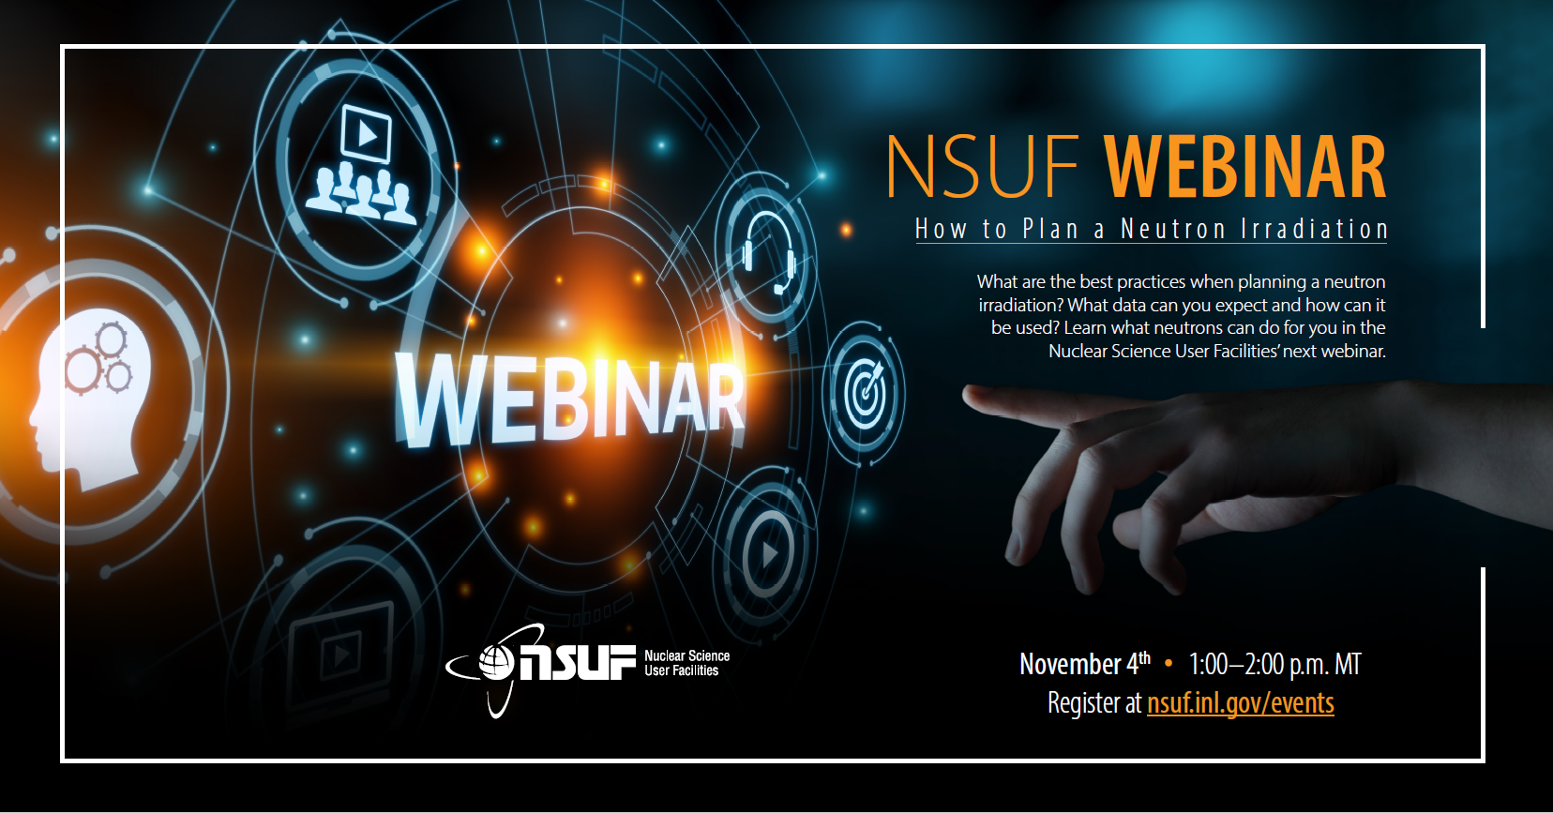
Webinar Series
Began in September 2020
Goal is to help users better understand how to utilize the NSUF’s capabilities
First two topics
Experiment Wizard demo
Neutron irradiation best practices

Slide 5
Annual Report
FY-19 annual report was completed in April
Included new Highlights and Short Communications section
Work has begun on FY-20 annual report

Slide 6
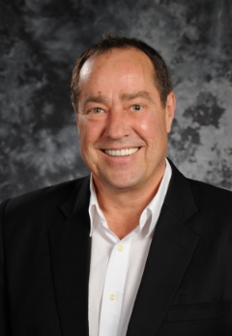
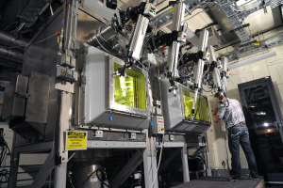
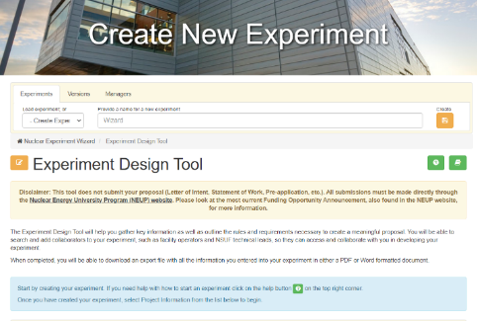
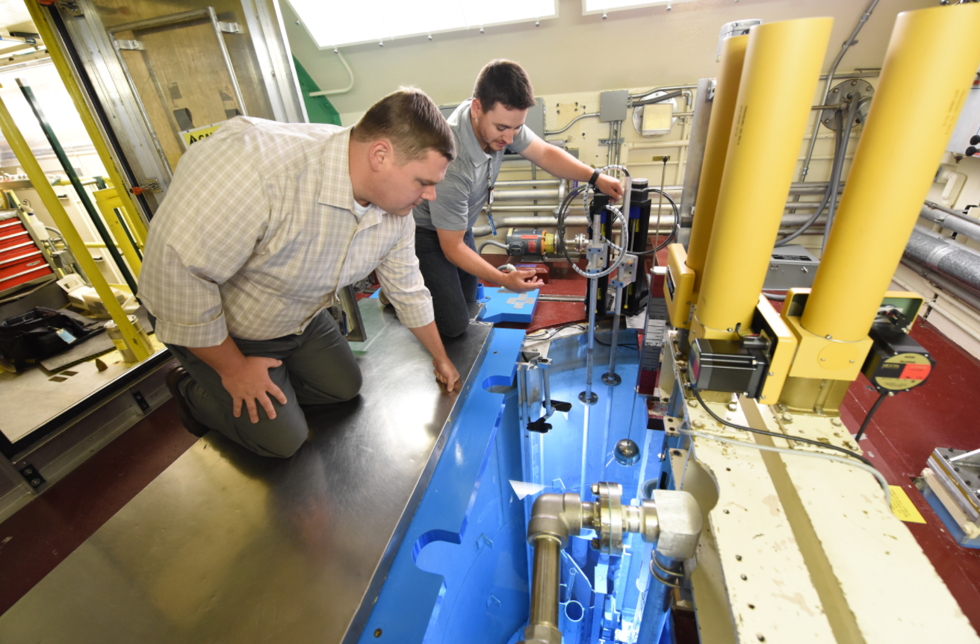
Future Activities
Feature stories
Project and journal article specific feature stories
Experiment Wizard overview
Rory’s ANS Fellow announcement (already written)
NSUF’s impact on industry (already written)
Experiment Wizard fact sheet
FY-20 annual report
New presentation template
Webinar
Ion irradiation best practices
Converting mechanical property measurements from micro to macro scale
Neutron v. X-ray v. synchrotron tomography
In situ TEM best practices
How experimentalists create useful modeling and simulation data
New NSUF Communications Lead to be hired. Tiffany to begin a new job at INL on 11/16.

