Slide 1
The Nuclear Fuels and Materials Library
The Nuclear Science User Facilities
Kelly Cunningham NFML Coordinator
FY 2020 Annual Review
November 9-10, 2020
LRS/EXT-20-00709

Slide 2
The NUCLEAR FUELS AND MATERIALS LIBRARY
FY 2020 Status Review
Utilization
Publications
FY 2020 Inventory Status … and beyond
FY 2020 Repository Status … and beyond
Outreach
Summary

Slide 3
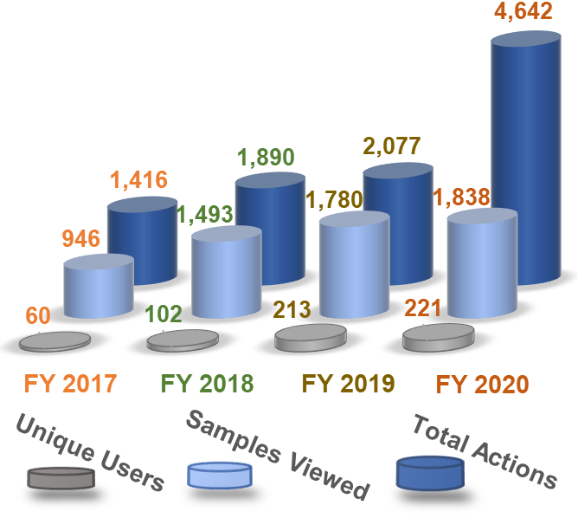
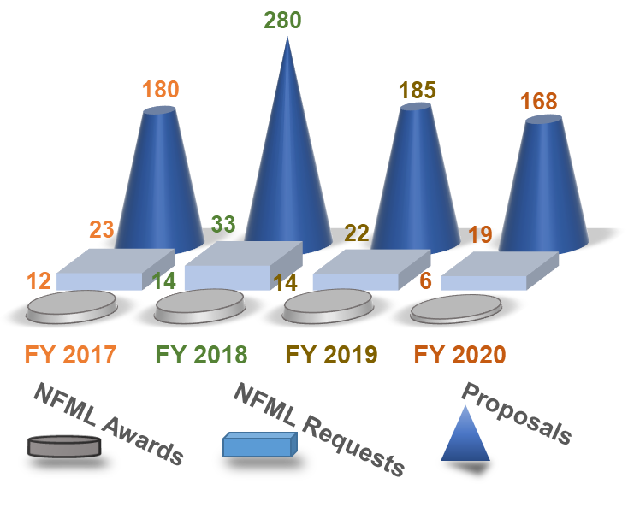
The NUCLEAR FUELS AND MATERIALS LIBRARY
Utilization
Database Utilization
RTE Sample Utilization
Notes:
Total actions increased much more in 2020 because a new action, browse by material, was added to the group of actions.
NFML Requests have remained around 12% each year. Only 2 RTE calls in 2020.

Slide 4


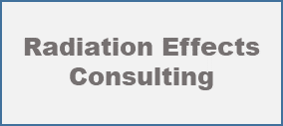






The NUCLEAR FUELS AND MATERIALS LIBRARY
Sample Utilization
FY 2020 Awarded Institution | Awarded RTE Title | Requested Samples | NSUF Project Samples
2929 | Effects of cold rolling and induction casting on the microstructural evolution in irradiated uranium-10wt.% molybdenum (U-Mo) alloys | Metallic Fuel U-Mo | University of Central Florida - Low Fluence Behavior of Metallic Fuels
2946 | Unraveling the Mystery of Irradiation-Induced Void Closure | 304 SS | EBR-II Legacy Hexblocks and Assemblies
2954 | Radiation-accelerated, strain-induced martensitic transformation and its potential impact on performance of 304 stainless steel irradiated to high doses in PWRs following plant life extension | 304 SS | EBR-II Legacy Hexblocks and Assemblies
2997 | Post-irradiation Microstructure Characterization of Radiation-Tolerant Piezoelectric Materials | BiTiO | Transducers for In-Pile Ultrasonic Measurements of Fuels and Materials Evolution
4094 | Radiation effect to the deformation mechanism of Alloys 800H and 800H-TMP | 800H, 800H-TMP | University of Wisconsin (2008) - Neutron irradiations of structural materials of relevance to nuclear reactor systems
4201 | Microstructural characterization of neutron irradiated HT-9 heats (ORNL, LANL and EBR II) at LWR and fast reactor relevant temperatures | HT-9 | University of Wisconsin (2008) - Neutron irradiations of structural materials of relevance to nuclear reactor systems
CINR 19122 | CINR: Effect of neutron irradiation on microstructure and mechanical properties of nanocrystalline nickel | Cu, ECAP, Ni | Influence of Fast Neutron Irradiation on the Mechanical Properties and Micro-structure of Nanostructured Metals/Alloys
 | REQUEST: NDE ultrasonic interrogation techniques to determine void swelling & other microstructural components for application to PWR pressure vessel internals. | 304 SS | EBR-II Legacy Hexblocks and Assemblies
Notes:
6 awarded RTEs, a CINR, and a request granted by the NFUS director utilized NFML samples

Slide 5

The NUCLEAR FUELS AND MATERIALS LIBRARY
CY 2020 NFML-Related Publications
NFML Samples | Publications
Hex Surv | Effect of laser welding on deformation mechanisms in irradiated austenitic stainless steel, Journal of Nuclear Materials, 528, 151878
 | Role of cavities on deformation-induced martensitic transformation pathways in a laser-welded, neutron irradiated austenitic stainless steel, Scripta Materialia, 178, 1-6
 | A transmission electron microscopy study of EBR-II neutron-irradiated austenitic stainless steel 304 and nickel-based alloy X-750, Journal of Nuclear Materials, 528, 1-9
UCSB-2 | A novel approach to determine the local burnup in irradiated fuels using Atom Probe Tomography (APT), Journal of Nuclear Materials, 528
 | Using alpha hulls to automatically and reproducibly detect edge clusters in atom probe tomography datasets, Materials Characterisation, 160, 110078
 | The effect of composition variations on the response of steels subjected to high fluence neutron irradiation, Materialia, 11, 100717
 | A more holistic characterisation of internal interfaces in a variety of materials via complementary use of transmission Kikuchi diffraction and Atom probe tomography, Applied Surface Science, 528, 147011
 | On the use of charged particles to characterize precipitation in irradiated reactor pressure vessel steels with a wide range of compositions, Journal of Nuclear Materials, 536, 152173
Notes:
Publications and presentations are collected by calendar year (not fiscal). Numerous publications resulted from UCSB-2 project that completed PIE last year and from Purdue students of a previous NSUF-awarded PI turned professor.

Slide 6
The NUCLEAR FUELS AND MATERIALS LIBRARY
CY 2020 NFML-Related Publications
NFML Samples | Publications
UCSB-1 | Microstructural examination of neutron, proton and self-ion irradiation damage in a model Fe9Cr alloy, Journal of Nuclear Materials, 533, 152130
UW | Rate Theory Model of Irradiation-Induced Solute Clustering in b.c.c. Fe-Based Alloys, Journal of Minerals, Metals & Materials Society, 72(9)
 | Method for Evaluating Irradiation Effects on Flow Stress in Fe-9%Cr ODS Using TEM In Situ Cantilevers, Journal of Minerals, Metals & Materials Society, 72, 2065-2074
 | Understanding plasticity in irradiated alloys through TEM in situ compression pillar tests, Journal of Materials Research, 35, 1037-1050
 | Comparison of microstructure evolution in Fe2+ or neutron-irradiated T91 at 500°C, Materialia, 12, 100770
 | The correlation between microstructure and nanoindentation property of neutron-irradiated austenitic alloy D9, Acta Materialia, 195, 1-13
17-865 SURV EBR-II | Enhanced Resistance to Irradiation Induced Ferritic Transformation in Nanostructured Austenitic Steels, Materialia, 13, 100806
 | Effects of proton irradiation on microstructure and mechanical properties of nanocrystalline Cu–10at%Ta alloy, Materialia, 9, 100597
Notes:
Publications and presentations are collected by calendar year (not fiscal)

Slide 7
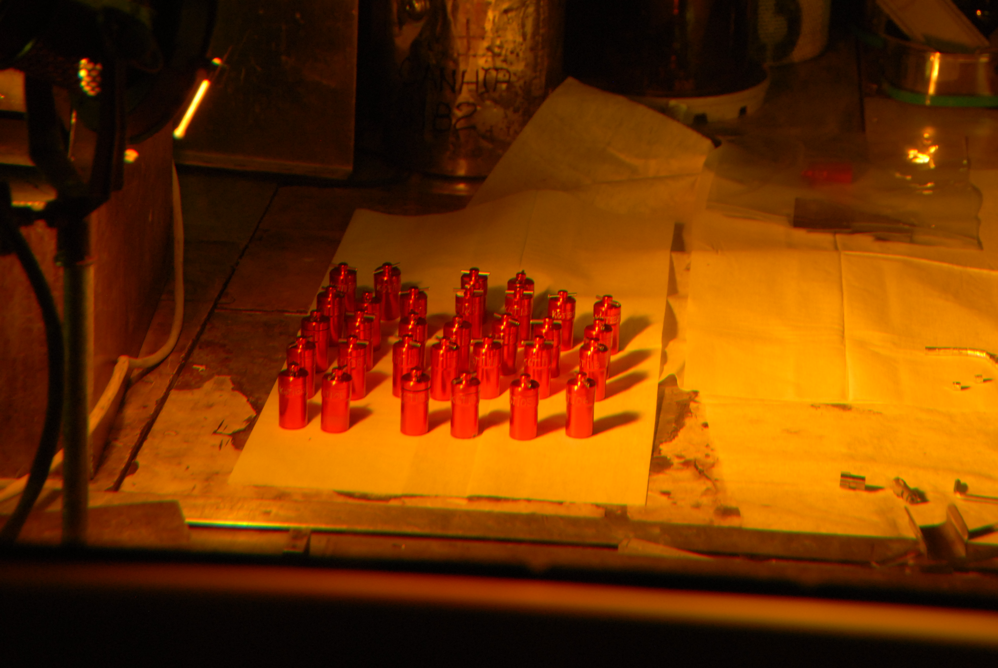

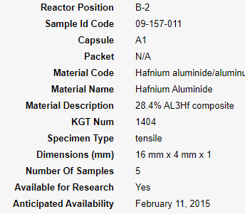
The NUCLEAR FUELS AND MATERIALS LIBRARY
FY 2020 Inventory Status
>
Inventory Growth
FY 2016
FY 2017
FY 2018
FY 2019
FY 2020
Some IDs/KGTs have duplicate samples
Notes:
There are many more samples in the NFML than 6800 as many samples have exact duplicates that are noted in Number of Samples within the library record.

Slide 8



The NUCLEAR FUELS AND MATERIALS LIBRARY
FY 2020 Inventory Status
  NSUF-awarded ATR irradiation samples added to NFML (not available until PIE complete ~2023):
  BSU 15-8242 1 DPA
    Steel Alloys
    Title: Irradiation Influence on Alloys Fabricated by Powder Metallurgy and Hot Isostatic Pressing for Nuclear Applications
    BSU 3 DPA to be added in FY 2021 (available ~2024)
    Extra Hf-Al samples irradiated in BSU capsules now available
  CSM 16-10584
    Steels/Alloys
    Title: Irradiation performance testing of specimens produced by commercially available additive manufacturing techniques
  GE-Hitachi 16-10393
    Steels/Alloys
    Title: Irradiation Testing of LWR Additively Manufactured Materials
  UCSB-2 09-153 PIE completed in 2020, samples to be added soon
    Various RPV steels (~1,500 samples to be added, available in FY 2021)
    Title: High Fluence Embrittlement Database and ATR Irradiation Facility of LWR Vessel Life Extension
Notes:
BSU 2015 CINR, CSM 2016 CINR, GE Hitachi 2016 CINR
Many additively manufactured samples will be added.
PIE for UCSB was completed in 2019/2020. The samples will be added when a complete list of samples and locations are compiled.

Slide 9

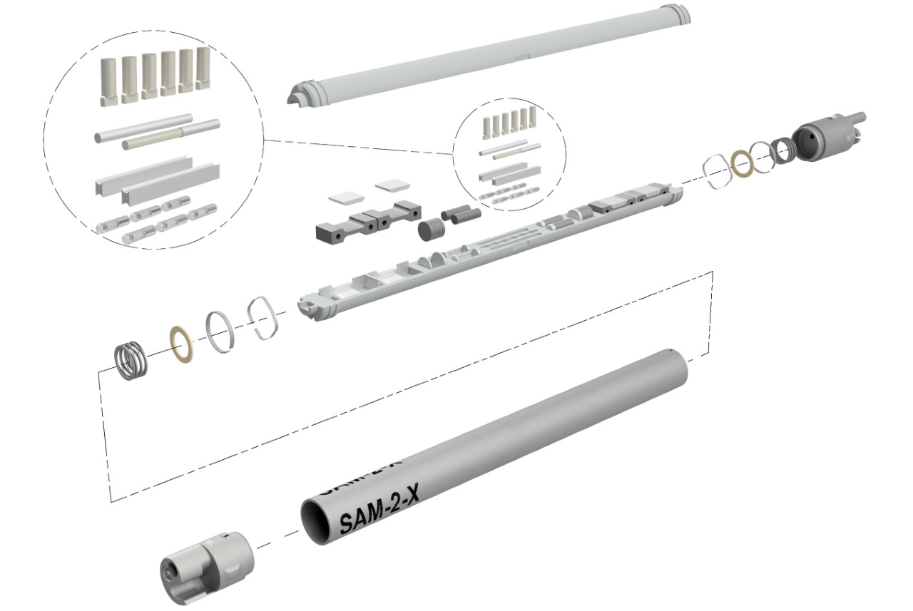
The NUCLEAR FUELS AND MATERIALS LIBRARY
FY 2020 Inventory Status and beyond
Future Samples to be Added
Future Samples to be Added
Future Samples to be Added
Future Samples to be Added
Future Samples to be Added
Future Samples to be Added
Future Samples to be Added
Future Samples to be Added
Future Samples to Be Added
Future Samples to be Added
Future Samples to be Added
Future Samples to Be Added
  SAM-2
    Non-fueled drop-in irradiation of high-purity silicon carbide (SiC) samples. The study will be achieved through increasing levels of neutron transmutation doping (NTD) of high-purity SiC by thermal neutron-capture reactions during irradiation. Eight experiment capsules will be loaded with sets of high-purity SiC samples. Individual capsules will be removed upon achieving a pre-determined level of doping (P-concentration).
    Scheduled for insertion into the ATR in January 2021. Complete after 12 (60-day) cycles.
    The first experiment to utilize the SAM-2 design team’s “standard capsule” design. This capsule design will save substantial time and money in future experiments by allowing investigators an approved design for irradiating tensile, 3-mm disc, and 6-mm disc specimens.
Notes:
Scheduled to be removed ~2023. Some samples will undergo PIE and the rest will be added to the NFML for researchers’ use.

Slide 10



The NUCLEAR FUELS AND MATERIALS LIBRARY
FY 2020 Inventory Status and beyond
More Future Samples to be Added
More Future Samples to be Added
More Future Samples to be Added
More Future Samples to be Added
More Future Samples to be Added
More Future Samples to be Added
More Future Samples to be Added
More Future Samples to be Added
More Future Samples to Be Added
More Future Samples to be Added
More Future Samples to be Added
More Future Samples to Be Added
Future NSUF-awarded ATR irradiation samples to be added to NFML
Project | Material Type | Samples | Irradiation (projected) | *Availability (projected)
ISU 16-10537 Nanostructured Steels for Enhanced Radiation Tolerance | Steels/Alloys | Fe-Cr & high-entropy alloys | 1st set completed 2nd set in progress | ~2023 ~2024
BSU-269 High Temperature In-Pile Irrad Test of Single Phase U₃Si | Fuel | U₃Si₂ | Capsule 1 completed Cpsl 2: 2021 | ~2024 ~2027
EPRI-ZG-C and -D (CRADA) Zirconium Growth Experiment | Ceramics | Zr alloys | ZG-C: Oct 2020 ZG-D: 2021 | ~2024 ~2025
18-14788 ATAMM – Aeroprobe Test of Additively Manufactured Materials | Steels | AM 316L | Completion: Mar 2021 | ~2024
19-16583 OSU NOeMAD - Nuclear Operations Effect on Mobility and Accelerated Diffusion TREAT Irradiation | Ceramics | Zr-based Cr coatings | TREAT irrad.: April 2021 | ~2024
*Implies a prior 3-year exclusive use by PIs for PIE

Slide 11





The NUCLEAR FUELS AND MATERIALS LIBRARY
FY 2020 Inventory Status and beyond
Even More Future Samples to be Added
Even More Future Samples to be Added
Even More Future Samples to be Added
Even More Future Samples to be Added
Even More Future Samples to be Added
Even More Future Samples to be Added
Even More Future Samples to be Added
Even More Future Samples to be Added
Even More Future Samples to Be Added
Even More Future Samples to be Added
Even More Future Samples to be Added
Even More Future Samples to Be Added
Even more future NSUF-awarded ATR irradiation samples to be added to NFML
Project | Material Type | Samples | Irradiation (projected) | *Availability (projected)
EPIC-THOR – Pre-Irradiated Conductivity Experiment TREAT Irradiation | Alloy Fuel | Fresh U-Pu-Zr, EBR-II U-Zr | TREAT irrad. ~2022 | ~2025/26
MVP – MARMOT Validation Project | Alloy Fuel | U-Zr | ~2021 | ~2025/26
19-16547 NuScale – NuScale SMR Materials Irradiation and Testing | Steels/Alloys | SA508, F6NM | ~2022 | ~2025/26
FINESSE – Fracture of Irradiated Neutron Embrittled Structural Steel and Examination | Steels/Alloys | Low-alloy A508 | ~2022 | ~2025/26
DISECT (CRADA) – Disc Irradiation for Separate Effects Testing with Control of Temperature | Alloy Fuel | U-Zr | ~2022 | ~2025/26
*Implies a prior 3-year exclusive use by PIs for PIE

Slide 12
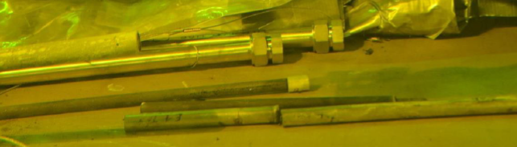
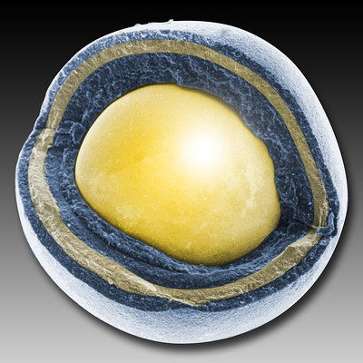


The NUCLEAR FUELS AND MATERIALS LIBRARY
As a Repository in FY 2020 and beyond
Added in 2020:
Joint Fuel Cycle Studies Program
Peach Bottom commercial reactor fuel
In Process:
Advanced Gas Reactor Program
unirradiated TRISO particles
Core shroud boat 304 SS samples
Title transfer in process
TerraPower
BOR-60-irradiated steel/alloy TEM samples
Notes:
Repository for valuable material and samples that may otherwise be lost in storage, forgotten or considered waste but must be preserved and made available for research.
NSUF staff were contacted to offer materials that must be available for research.

Slide 13



The NUCLEAR FUELS AND MATERIALS LIBRARY
As a Repository in FY 2020 and beyond
Potential Additions:
KAERI/INL
CRADA
Fuel plate material from the Ki-Jang Research Reactor (KJRR) project
Westinghouse
316 SS baffle former bolts (last year, we added 347 SS baffle former bolts provided by Westinghouse)
Halden Reactor Project
DOE-NE/NRC/EPRI request for structural material samples from the Halden research reactor
Notes:
Additional material that has been offered to the NFML for curation.
NSUF staff are working with DOE-NE/NRC/EPRI to get structural samples from the Halden Research Reactor.

Slide 14
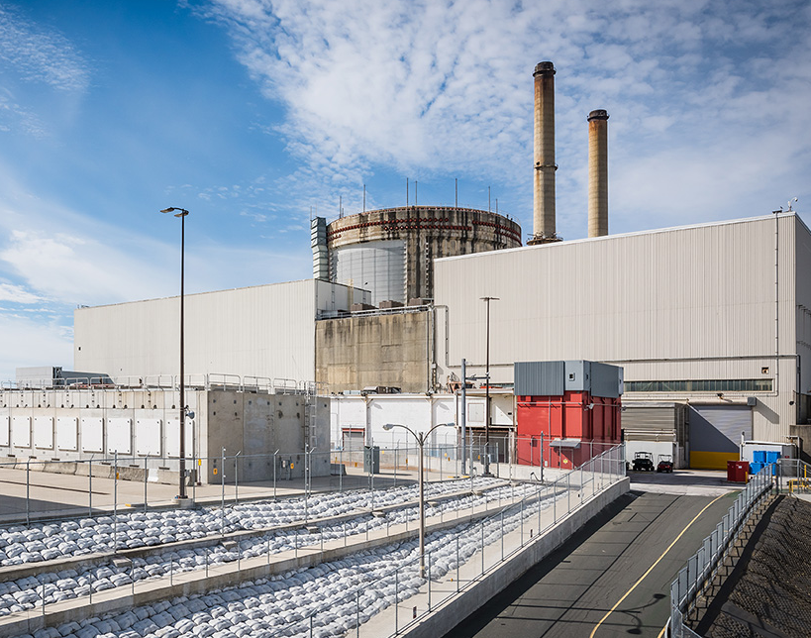
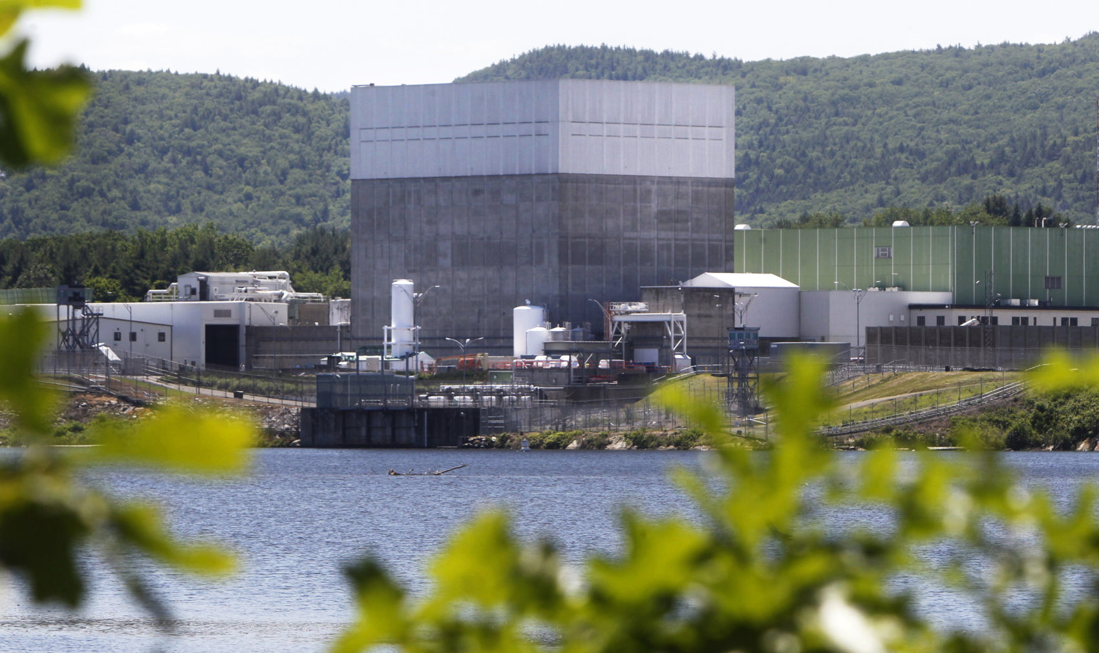
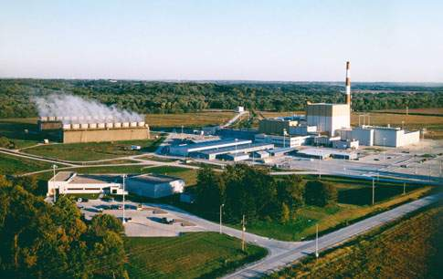
The NUCLEAR FUELS AND MATERIALS LIBRARY
As a Repository in FY 2020 and beyond
Harvesting Possibilities:
Crystal River NPP (Florida)
Vermont Yankee NPP (Vermont)
Duane Arnold NPP (Iowa)
Notes:
NSUF staff are working with ORANO to obtain material and samples from decommissioned reactors.

Slide 15

The NUCLEAR FUELS AND MATERIALS LIBRARY
Outreach
  Survey request for input on future needs regarding nuclear energy-related materials
    NSUF registered users
    Nuclear research contacts
    Chairs from the Fast Reactor, Molten Salt Reactor, and
    High-Temperature Reactor Technology Working Groups
    INL Facebook and Twitter
    Low response numbers but valuable information—most requests
    were for materials already in NFML or to be added once CINR
    samples become available.
    Email from contact who missed the survey window:
    Chairman of the VGB* work panel on component integrity
“Specimens from >30 years exposed components coming available due to the ongoing phase-out of German LWRs” - German LWR components
  UK Irradiated Material Archive Options Study (conducted with universities and supply chain organizations) – discussions on creating their database
  Harvesting group (NRC, DOE-NE, EPRI, ORNL) – NFML representation in group meetings and updates
Good News?
Bad News?
*International Association of Energy Plant Operators, representing NPP operators in Germany, Belgium, France, the Netherlands, and Switzerland

Slide 16
The NUCLEAR FUELS AND MATERIALS LIBRARY
Summary
Utilization of the NFML databased increased. RTE requests for NFML samples maintained status quo.
The NFML inventory increased thanks to new additions from:
    BSU
    CSM
    GE-Hitachi.
NSUF-awarded projects will generate many additional samples over the next 3–7 years.
Calendar year publications related to NFML samples are doing well thanks to the completion of UCSB-2 PIE and NSUF-awarded PIs turned professors.
The NSUF SAM-2 irradiation project is underway to add SiC to the NFML and provide a new capsule design that will save time and money on future experiments.
A survey request for input showed that the existing NFML database samples are relevant to current research but some researchers aren’t aware of them or can’t find by searching.
The NFML is being nationally and internationally recognized and sought out as a repository for valuable materials.
As always, the NFML staff welcome your questions, suggestions, comments, and constructive critiques.

Slide 17
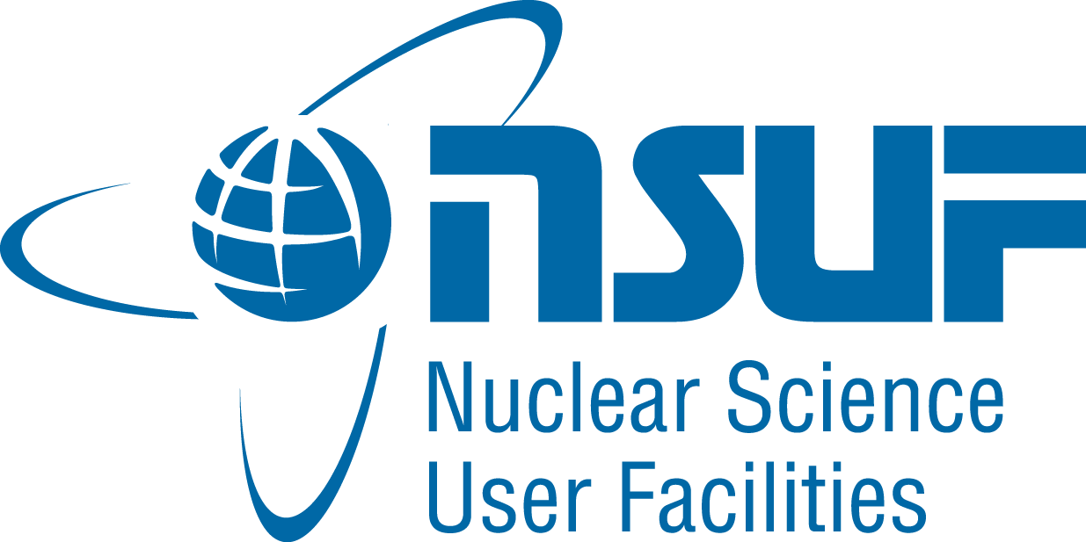
The NUCLEAR FUELS AND MATERIALS LIBRARY
Contact Information
Kelly Cunningham
(208) 526-2369
Kelly.Cunningham@INL.gov

