Slide 1
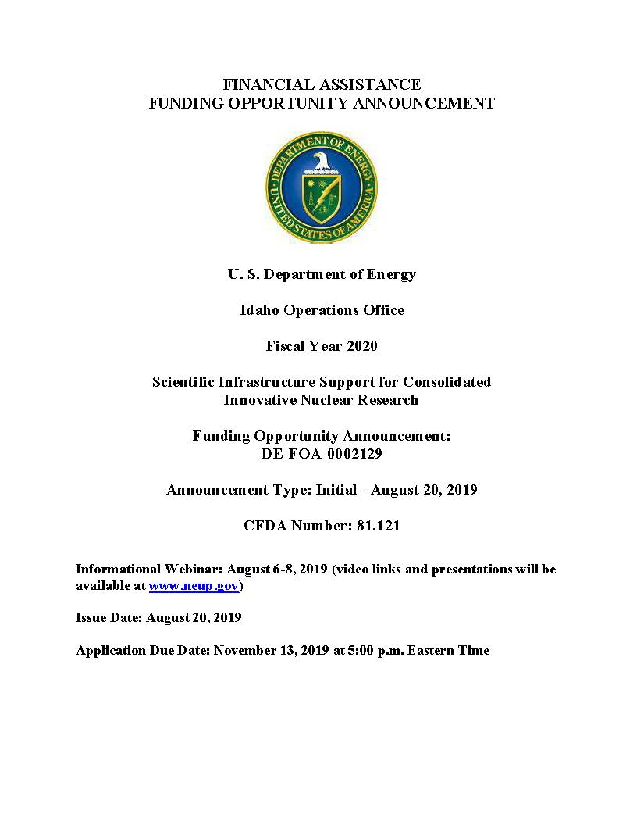
Infrastructure Awards
Simon M. Pimblott
Brenden Heidrich
FY 2020 Annual Review November 9–10, 2020

Slide 2
Scientific Infrastructure Support for Consolidated Innovative Nuclear Research
The Nuclear Energy University Program (NEUP) utilizes up to 20% of funds appropriated to the NE R&D program for university-based infrastructure support and R&D in key areas related to the NE program:
• Fuel Cycle Research and Development (FC R&D)
• Reactor Concepts Research, Development, and Demonstration (RC RD&D)
• Nuclear Energy Advanced Modeling and Simulation (NEAMS)
The infrastructure requested should be individual, discrete, definable items or capabilities to:
• Support, maintain, or enhance the institutions’ capacities to attract and teach high-quality students interested in nuclear-energy-related studies
• Build the institutions’ research and/or education capabilities
• Enhance the institutions’ capabilities to perform R&D relevant to DOE-NE’s mission.

Slide 3
University Research Reactor Upgrades Infrastructure
Purposes of the program:
To upgrade and improve U.S. university nuclear research and training reactors
To help strengthen the academic community’s nuclear engineering infrastructure
To upgrading the research reactor
by the purchase of (or for maintenance of) equipment and instrumentation for activities related to the safety, performance, control, or operational reliability of the research reactor, including security/safety enhancements required by federal/state/local regulatory agencies
for equipment and instrumentation that significantly improves or expands the research, instruction, training capabilities, or operating capabilities of NE program missions (e.g., utilization or handling of radiological or radioactive materials) pertaining to the research reactor facility, including equipment for detecting and measuring radiation.
The primary aim of the funding opportunity announcement is safety.

Slide 4
Eligible Institutions
1 Idaho State University 13 The Ohio State University
2 Kansas State University 14 University of California, Davis
3 Massachusetts Institute of Technology 15 University of California, Irvine
4 Missouri University of Science & Technology 16 University of Florida
5 North Carolina State University 17 University of Maryland, College Park
6 Oregon State University 18 University of Massachusetts, Lowell
7 Pennsylvania State University 19 University of Missouri, Columbia
8 Purdue University 20 University of New Mexico
9 Reed College 21 University of Texas at Austin
10 Rensselaer Polytechnic Institute 22 University of Utah
11 Rhode Island Nuclear Science Center 23 University of Wisconsin, Madison
12 Texas A&M University 24 Washington State University

Slide 5
Merit Review Criteria
(55%) Safety and/or Security – Potential of the requested equipment, instrumentation, or modification to:
Enhance the safety, performance, control, or operational reliability of research reactor systems
Increase the quality, safety/security, or efficiency of research reactor facility operations
(15%) Impact – Potential of the requested equipment, instrumentation, or modification to facilitate, improve, or expand ongoing Office of Nuclear Energy research and training capabilities
(15%) Utilization – The amount of student and faculty usage of the research reactor facility, as a result of the proposed equipment, and the amount and variety of research and/or services actually provided by the facility.
(15%) Execution – Capability of implementing the full scope of the project, including timely project completion, personnel qualifications, budget, and feasibility.

Slide 6
FY 2020 Awards (9)
Title | Institution | Estimated Funding*
A New Control Rod Drive Mechanism Design for the ISU AGN-201M Reactor | Idaho State University | $59,262
University Research Reactor Upgrades Infrastructure Support for the MIT Research Reactor’s Normal and Emergency Electrical Power Supply Systems | Massachusetts Institute of Technology | $537,818
Furthering Oregon State University to Meet Nuclear Science and Engineering Research Challenges Through Reactor Upgrade Investment – Increasing Material Science Capability | Oregon State University | $118,020
Underground Waste Storage Tanks Removal and Installation of New Above Ground Waste Storage Tanks and Waste Evaporator Pit at the Radiation Science and Engineering Center | Pennsylvania State University | $306,744
PUR-1 Water Processing and Cooling System Upgrade | Purdue University | $36,000
Reactor Safety Control Component Upgrade | Rhode Island Nuclear Science Center | $477,000
Equipment Upgrades at University of Massachusetts Lowell Research Reactor (UMLRR) to enable neutron-induced reaction research | University of Massachusetts, Lowell | $129,788
University of Missouri Research Reactor Beryllium Reflector Replacement | University of Missouri, Columbia | $585,013
Reactor Cooling System Upgrade for the University of Utah TRIGA Reactor | University of Utah | $487,387

Slide 7
General Scientific Infrastructure Support
Universities are permitted to submit a single application to the General Scientific Infrastructure Support section.
Applications can be submitted for equipment, software, instrumentation, and associated non-reactor upgrade requests that support nuclear-energy-related R&D or education.
Funding requests may include, but are not limited to, equipment and instrumentation for specialized facilities, classrooms and teaching laboratories, and non-reactor NS&E research.
Infrastructure requests that support the sharing/usage of equipment and instrumentation by national laboratories, multiple universities, or multiple campuses on a university are encouraged.
For requests above $250,000, cost matching is required for universities on a 1:1 basis

Slide 8
Merit Review Criteria
(25%) Impact – Potential of the requested equipment, instrumentation, or modification to facilitate, improve, or expand ongoing Office of Nuclear Energy research and training capabilities
(25%) Utilization – The amount of student, faculty, or researcher usage of the capabilities as a result of the proposed equipment, and the amount and variety of research and/or services actually provided by the facility
(25%) NSUF Priority – The proposed upgrade’s importance to the Nuclear Science User Facilities either by improving an existing partner facility or as a potential partner facility
(25%) Execution – Capability of implementing the full scope of the project, including timely project completion, personnel qualifications, budget, and feasibility

Slide 9
FY 2020 Awards (12)
Title | Institution | Estimated Funding*
Enhancing Mechanical Testing Capabilities to Support High-throughput Nuclear Material Development | Auburn University | $210,398
A 3D Metal Printer to Enable Innovations in Nuclear Materials and Sensors | Boise State University | $319,941
High-Speed Thermogravimetry Equipped with Mass Spectrometry for Thermodynamic and Kinetic Study of Nuclear Energy Materials | Clemson University | $228,237
Development of an In-Situ Testing Laboratory for Research and Education of Very High Temperature Reactor Materials | North Carolina State University | $261,175
Scanning Electron Microscope for nuclear materials investigation enabling in-situ techniques and novel characterization for the nuclear energy community | University of California, Berkeley | $265,000
Development of a High Throughput Nuclear Materials Synthesis Laboratory | University of Michigan | $166,560
Infrastructure Support for In-situ Transmission Electron Microscopy Examination of Structure, Composition and Defect Evolution of Irradiated Structural Materials at University of Nevada, Reno | University of Nevada, Reno | $343,147
Establishment of Remote Control High Temperature Mechanical Testing Facility in a Hot Cell at The University of New Mexico | University of New Mexico | $250,000
High Temperature Thermophysical Properties of Nuclear Fuels and Materials | University of Pittsburgh | $300,000
Ex-situ and in situ Molten Salt Chemical Analysis Capabilities for the Development of Materials in Molten Salt Environments | University of Wisconsin-Madison | $263,000
A Customized Creep Frame to Enable High-Throughput Characterization of Creep Mechanism Maps | Utah State University | $160,000
Laboratory-based High-Resolution X-ray Absorption and Emission Spectroscopy for Nuclear Science and Radiochemistry Research and Education | Washington State University | $287,450

Slide 10
Summary of FY 2020 Awards
 | Total Funding | Number of Awards
Research Reactor Upgrades | $2,737,032 | 9
GSI | $3,054,908 | 12

Slide 11
QUESTIONS?

