Slide 1
Improving Lifetime Prediction of Electrical Cables in Containment
Leo Fifield
Nuclear Science User Facilities
FY2020 Annual Program Review
10 November 2020
NSUF CINR 20-19145, L. Fifield, PNNL

Slide 2

LWRS
Plant Modernization Pathway
Flexible Plant Operation and General Technical Program Plan Pathway
Risk-Informed Systems Analysis Pathway
Materials Research Pathway
Physical Security Pathway
Address economic viability in current, future energy markets through innovation, efficiency gains, and business model transformation using digital technologies.
Identify opportunities/ develop methods for LWRs to directly supply energy to industrial processes to diversify approaches to revenue generation.
Develop and deploy risk-informed tools and methods to achieve high levels of safety and economic efficiencies.
Develop the scientific basis for understanding & predicting long-term environmental degradation behavior of materials in Nuclear Power Plants.
Develop methods, tools, and technologies to optimize and modernize a nuclear facility's security posture.​
2
Leo Fifield (leo.fifield@pnnl.gov)

Slide 3
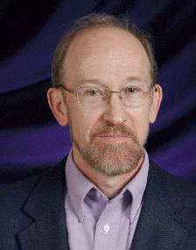
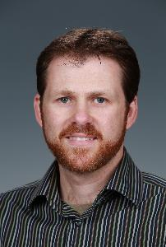




Materials Research Pathway Cable Tasks
Materials Research Pathway
Pathway Lead –Tom Rosseel (ORNL)
Cable Aging Task
Leo Fifield (PNNL)
Robert Duckworth (ORNL)
Cable NDE Task
Bill Glass (PNNL)
3
Leo Fifield (leo.fifield@pnnl.gov)

Slide 4




University Collaborations via NEUP
Iowa State University/PNNL/WSU/AMS (FY15-17)
Advanced Models for Nondestructive Evaluation of Aging Nuclear Power Plant Cables
University of Minnesota Duluth/ORNL (FY17-19)
Quantifying Properties for a Mechanistic, Predictive Understanding of Aqueous Impact on Aging of Medium and Low Voltage AC and DC Cabling in Nuclear Power Plants
University of South Carolina/PNNL (FY18-20)
Novel NDE Sensors, Waveforms, Models, and Algorithms for Cable Health Monitoring
4
Leo Fifield (leo.fifield@pnnl.gov)

Slide 5
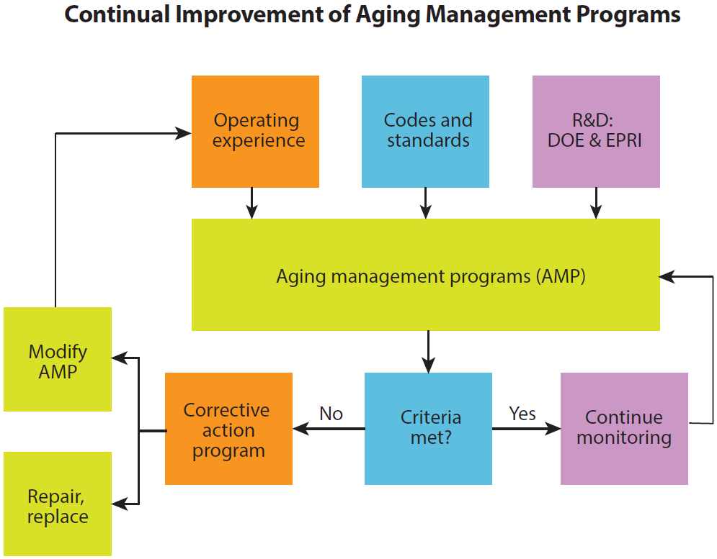
Cable Research Objectives
Aim: understand roles of material type, history, and operating environment on cable system degradation; understand accelerated testing limitations; and support modeling, surveillance, and testing
Support Subsequent License Renewal (SLR):
Cable Research supports analysis of Type Testing
Enable Advanced Cable Aging Management
Development and validation of condition monitoring methods
Support risk-based vs. time-based inspection
Develop technologies for aging cable mitigation
Reduce operating & maintenance costs
Cable Aging
“Effective programs require a technical understanding of aging effects, inspection and assessment techniques, mitigation measures, and guidance on repairs or replacements.” - NEI Second License Renewal Roadmap 2015
Cable NDE
Cable Aging
NEI Second License Renewal Roadmap 2015
5
Leo Fifield (leo.fifield@pnnl.gov)

Slide 6
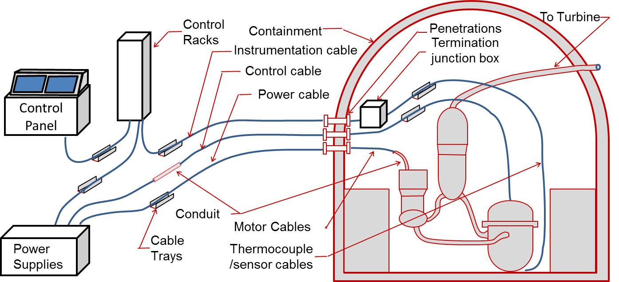
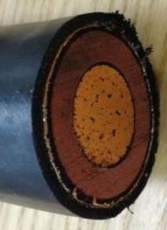
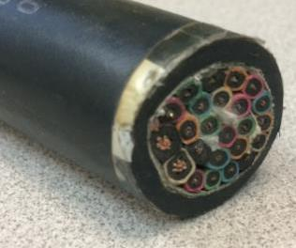
Electrical Cables in U.S. Nuclear Power Plants
PNNL-25432
Applications
Instrument and Control (81%)
Power Cables (15%)
Communication (5%)
Insulation
Cross-linked polyethylene (XLPE)
Ethylene-propylene rubber (EPR)
Silicone Rubber (SiR)
Jacketing
Hypalon® - Chlorosulfonated PE (CSPE)
Neoprene - Polychloroprene
CPE - Chlorinated polyethylene
PVC - Poly(vinyl chloride)
Medium voltage power cable
Low voltage Instrument & Control cable
6
Leo Fifield (leo.fifield@pnnl.gov)

Slide 7
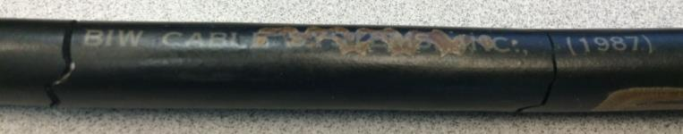
Polymers Degrade Over Time
Environment
Heat
Radiation
Moisture
Chemical Changes
Bond breaking/forming
Loss of additives
Defect initiation
Material Changes
Embrittlement
Dimensional change
Dielectric behavior changes
7
Leo Fifield (leo.fifield@pnnl.gov)

Slide 8
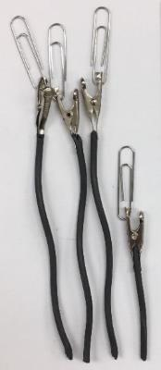
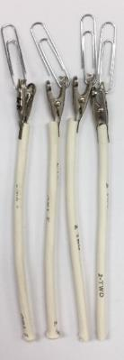
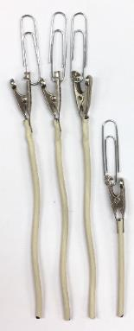
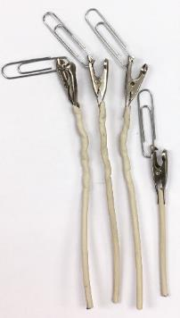
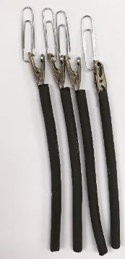
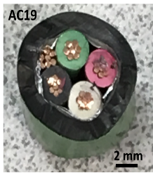
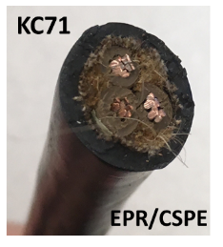
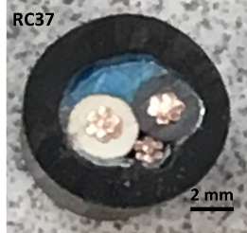
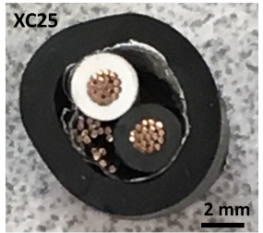
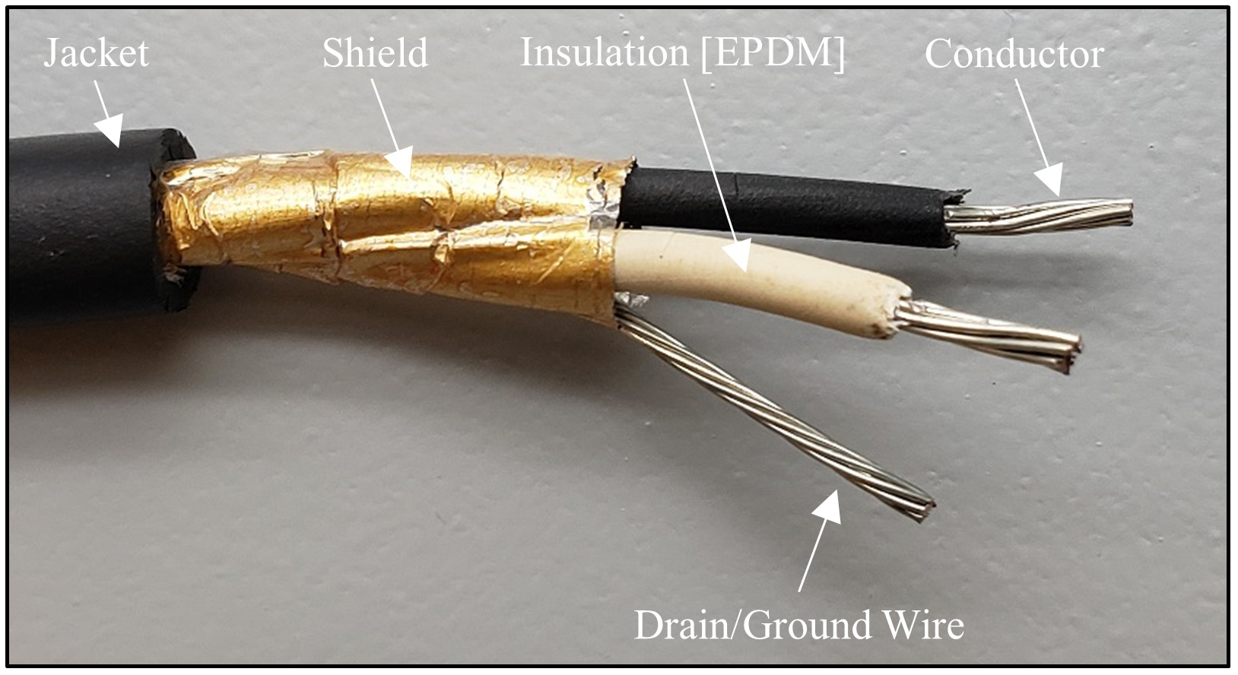
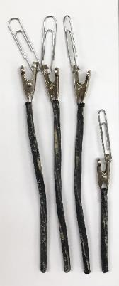
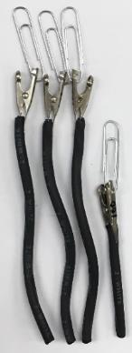
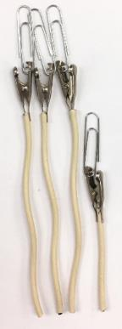
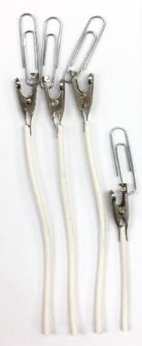
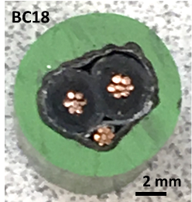
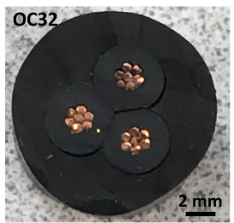
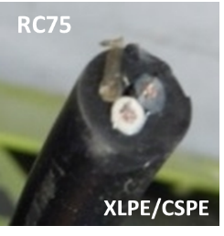
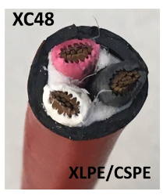
Cable Insulation Materials
Anaconda Flame-Guard FR-EP EPR
Samuel Moore Dekoron® EPDM
Kerite HTK
Rockbestos XLPE
Brand-Rex XLPE
RSCC Firewall® III XLPE
Brand-Rex Ultrol FR XLPE
BIW Bostrad 7E EPR-CSPE
Okonite FMR EPR
*Crystal River 3 harvested cables
8
Leo Fifield (leo.fifield@pnnl.gov)

Slide 9
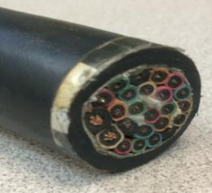
Cable Aging Management
Cable aging behavior & tools needed to assess condition are determined by cable:
  Component materials
  Construction and
  Operating environment
Environment
Aging &
Degradation
Materials
Condition
Monitoring
Construction
For example:
Low voltage BIW cable, circa 1987, EPR insulation & CSPE jacket
Unshielded, multi-conductor control rod cable
Installed for 30 years with exposure to 50°C and 0.1Gy/h
What is its expected remaining useful life?
Which NDE techniques can quantify its condition?
* EPR = ethylene-propylene rubber
CSPE = chlorosulfonated polyethylene
NDE = non-destructive evaluation
9
Leo Fifield (leo.fifield@pnnl.gov)

Slide 10
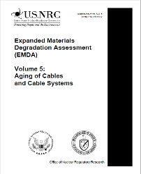
Cable Knowledge Gaps related to Subsequent License Renewal
NUREG/CR-7153 (2014)
Activation Energies
Diffusion Limited Oxidation
Moisture Effects
Dose Rate Effects
Inverse Temperature Effects
Actual Plant Environments
Sensitive Measures of Aging
NIST/NRC/SANDIA
Harvested Cables
EPRI/Crystal River/Zion
Accelerated Aging
HEF(PNNL)/HFIR(ORNL)
Advanced Surface Mapping
EC Joint Research Centre
Modeling, Integrated Test Bed
ORNL/NEUP UMN-Duluth
Rejuvenation/Mitigation Methods
10
Leo Fifield (leo.fifield@pnnl.gov)

Slide 11
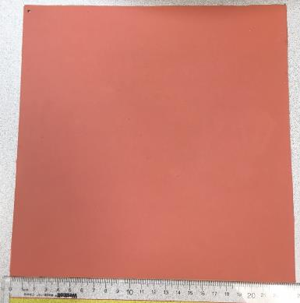
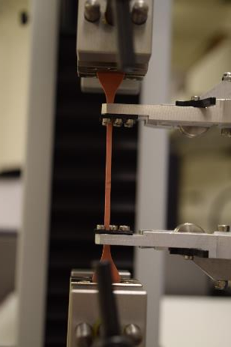
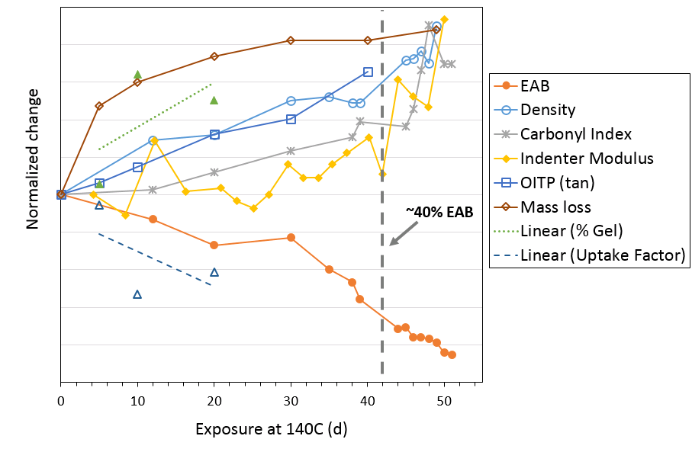
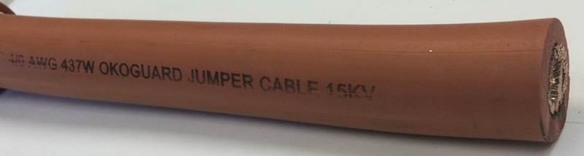

Thermal Degradation of Medium Voltage EPR Insulation
Indicators for physical/chemical changes in EPR material correlated in lifetime curve to support remaining useful life prediction
*EPR = Ethylene-propylene rubber
EAB = Elongation at Break
OITP = Oxidation Induction Temperature
Sensitive Measures of Aging
11
Leo Fifield (leo.fifield@pnnl.gov)

Slide 12
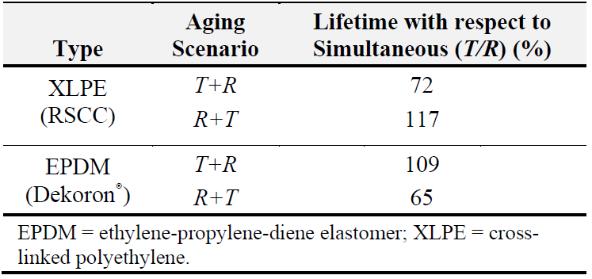
Sequential vs Simultaneous Aging: Elevated Temperature and Gamma Radiation (June 2020)
*Cable insulation samples exposed to 150°C and 300Gy/h.
Fifield L.S., M.P. Spencer, A. Zwoster, T.T. Bisel, and M.K. Murphy. 2020. Sequential Versus Simultaneous Aging of XLPE and EPDM Nuclear Cable Insulation Subjected to Elevated Temperature and Gamma Radiation. PNNL-30041
Most severe scenario seen to be material dependent
12
Leo Fifield (leo.fifield@pnnl.gov)

Slide 13
Accelerated Aging in Qualification
Manufacturer | Class | E_{a} (kJ/mol) | Test Temperatures
Rockbestos | XLPE | 130 | 121°C | 136°C | 150°C
BrandRex | XLPE |  | 121°C | 136°C | 150°C
Okonite | EPR | 131 | 121°C | 136°C | 150°C | 165°C | 180°C
BIW | EPR | 110 | 121°C | 136°C | 150°C |  | 180°C
Anaconda | EPR | 163 | 121°C | 135°C | 150°C | 160°C
2.3.2 Long-Term Physical Aging Properties.
Aging data should be submitted to establish long-term performance of the insulation. Data may be evaluated using the Arrhenius technique. A minimum of 3 data points, including 136 °C and two or more others at least 10 °C apart in temperature, should be used.
- IEEE Std 383-1974 “Standard For Type Test Of Class 1E Electric Cables, Field Splices, And Connections For Nuclear Power Generating Stations”
13
Leo Fifield (leo.fifield@pnnl.gov)

Slide 14
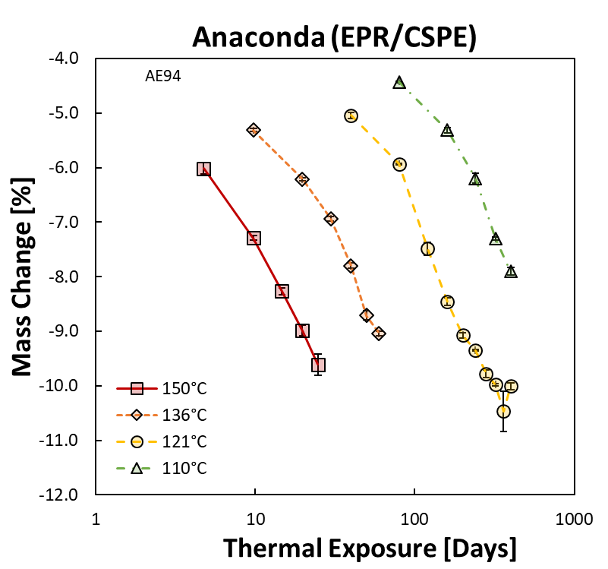
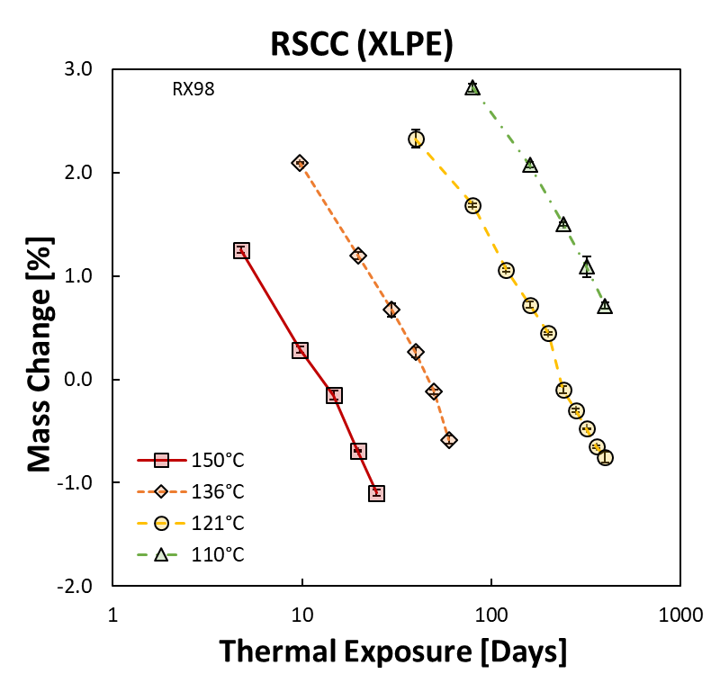
Tracking of Cable Degradation using Mass Change
Mass Change (Δm) of insulation polymers tracks with exposure to thermal stress throughout the exposure period, without the induction time characteristic of other degradation metrics.
This makes Δm potentially useful to predict cable aging from early exposure at temperatures much closer to service temperatures.
PNNL is using Δm to calculated thermal activation energies (E_{a}) for comparison to E_{a} from elongation and other standard metrics.
EPR = Ethylene propylene rubber
CSPE = Chlorosulfonated polyethylene
XLPE = Cross-linked polyethylene
Sensitive measures of aging such as Mass Change improving cable lifetime prediction.
14
Leo Fifield (leo.fifield@pnnl.gov)

Slide 15
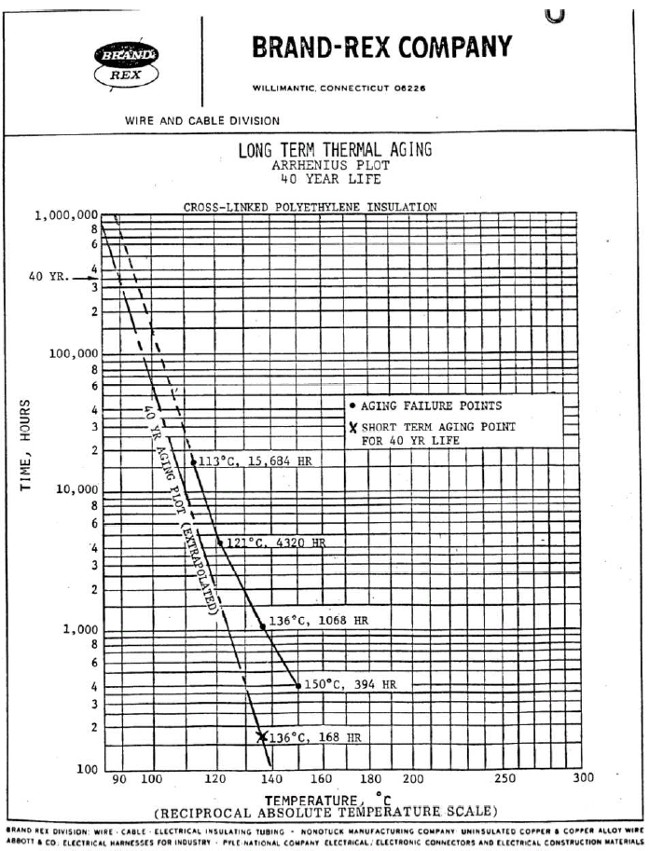
Temperature Regimes
Normal operating temperature: 90°C
XLPE Crystalline melting point: 125°C
Accelerated Aging
121°C – 180 days (0.5 yrs)
113°C – 654 days (1.8 yrs)
109°C – 810 days (2.2 yrs)
100°C – 2226 days (6.1yrs)
15
Leo Fifield (leo.fifield@pnnl.gov)

Slide 16
Temperature Regimes – Higher Temperatures
Normal operating temperature: 90°C
XLPE Crystalline melting point: 125°C
Accelerated Aging
121°C – 180 days (0.5 yrs)
113°C – 654 days (1.8 yrs)
109°C – 810 days (2.2 yrs)
100°C – 2226 days (6.1yrs)
High Temperature Slope
16
Leo Fifield (leo.fifield@pnnl.gov)

Slide 17
Temperature Regimes – Lower Temperatures
Normal operating temperature: 90°C
XLPE Crystalline melting point: 125°C
Accelerated Aging
121°C – 180 days (0.5 yrs)
113°C – 654 days (1.8 yrs)
109°C – 810 days (2.2 yrs)
100°C – 2226 days (6.1yrs)
Low Temperature Slope
17
Leo Fifield (leo.fifield@pnnl.gov)

Slide 18
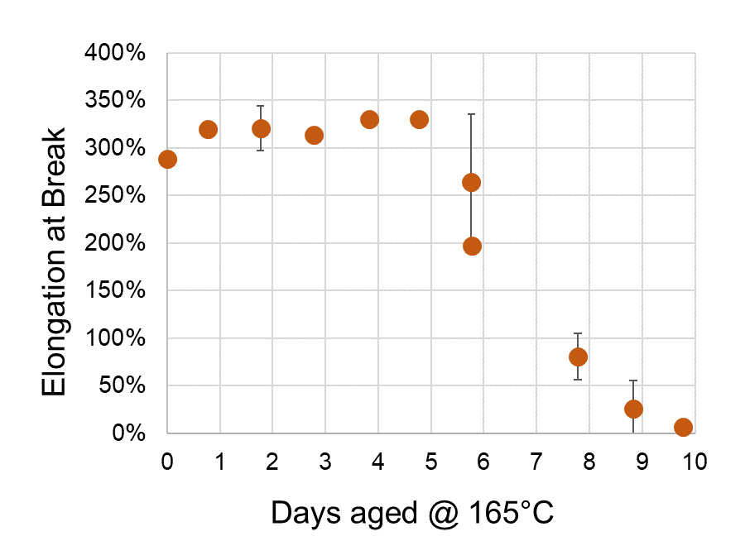
Tracking Polymer Aging
Thermally Aged Okoguard EPR
Bowler Group, ISU
18
Leo Fifield (leo.fifield@pnnl.gov)

Slide 19
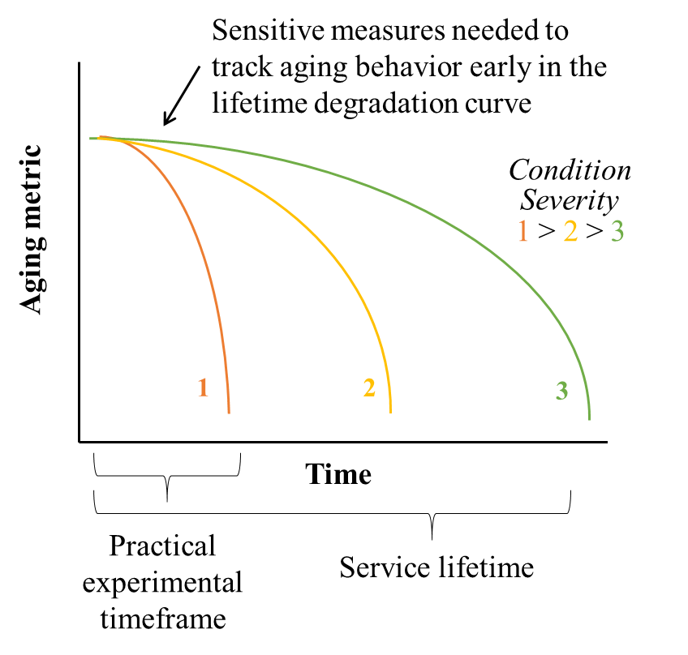
Challenge of Accelerated Aging
19
Leo Fifield (leo.fifield@pnnl.gov)

Slide 20
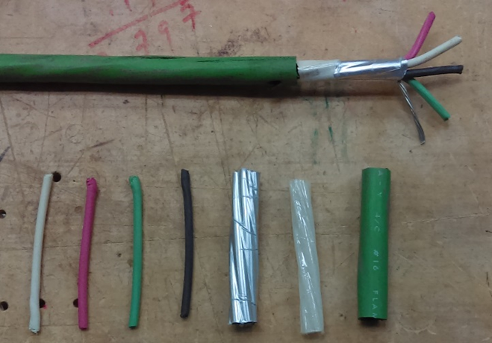
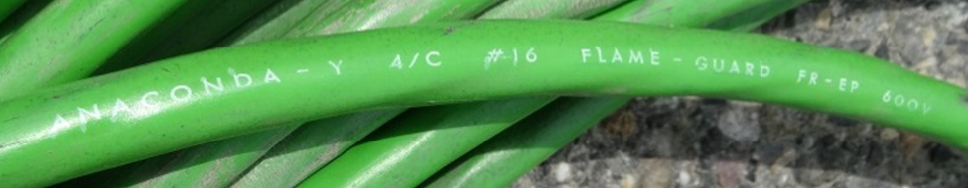
Developing Sensitive Measures of Radiation Effects
Gamma irradiation at 3 dose rates:
  300 Gy/h to 300 kGy
  200 Gy/h to 200 kGy
  100 Gy/h to 100 kGy
Characterization
  Oxygen consumption
  Dielectric properties
  Indenter modulus
  Tensile properties
  Density
  FTIR spectroscopy
Anaconda Flame-Guard FR-EP/CPE Cable components
20
Leo Fifield (leo.fifield@pnnl.gov)

Slide 21
Summary
Objectives
Measure aging indicator behaviors under severe stress condition
  – standard and novel sensitive measures of aging
Determine if early aging under mild stress condition can be observed using sensitive measures
Expected Outcomes
Demonstration of aging behavior from early signals of sensitive measures will enable:
  More effective condition monitoring – early tracking of cable material aging
  Accelerated aging at conditions closer to service conditions over practical time periods
21
Leo Fifield (leo.fifield@pnnl.gov)

