Slide 1
X-ray diffraction tomography analysis of SiC composite tubes neutron-irradiated with a radial high heat flux
NSUF FY2020 Annual Program Review
10 November 2020
PI: Takaaki Koyanagi (ORNL)
Co-PI: Yutai Katoh (ORNL), David Sprouster (Stony Brook University)
This study was supported by the US. DOE, Office of Nuclear Energy, for the Advanced Fuels Campaign of the Nuclear Technology R&D program under contact DE-AC05-00OR22725 with ORNL, managed by UT Battelle, LLC. The high-energy XRD experiments were supported by the Office of Nuclear Energy under DOE Idaho Operations Office Contract DE-AC07- 051D14517 as part of a Nuclear Science User Facilities experiment.

Slide 2
Project description
Title: X-ray diffraction tomography analysis of SiC composite tubes neutron-irradiated with a radial high heat flux
Program: NSUF-2.1 CORE AND STRUCTURAL MATERIALS
Application: accident tolerant fuel cladding of light water reactors
Program support: DOE NE Advanced fuel campaign
NSUF facility: NSLS-II XPD Beamline at Brookhaven National Laboratory
The overarching goal: experimentally verify the modeling results of SiC-based fuel clad subject to neutron irradiation under high radial heat flux, which is relevant to practical LWR fuel operation

Slide 3
Why SiC?
Low neutron absorption
Excellent high-temperature strength
Chemical stability
Radiation resistant
Negligible thermal creep below 1,000°C
Better fuel economy
No degradation of strength under LWR relevant dose and temperature
Steam oxidation resistant

Slide 4
Development of accident tolerant SiC based fuel cladding: recent focuses at ORNL
Irradiation effects
Irradiation under temperature gradient
Irradiation + hydrothermal corrosion
Bowing of clad
Fuel performance modeling
Stress state
Dimensional stability
Accident behavior
Coating development
Mitigations of loss of hermeticity and hydrothermal corrosion
Corrosion
Normal operations
Accident conditions

Slide 5
Fuel performance modeling of SiC based cladding
Multi-physics modelling
Material property database
Design and manufacture
Failure probability
Fuel performance model is required to assess performance of SiC cladding
Optimization of cladding/fuel design
Prediction of PCMI
Failure assessment
Validation of the model is a focus of this project

Slide 6
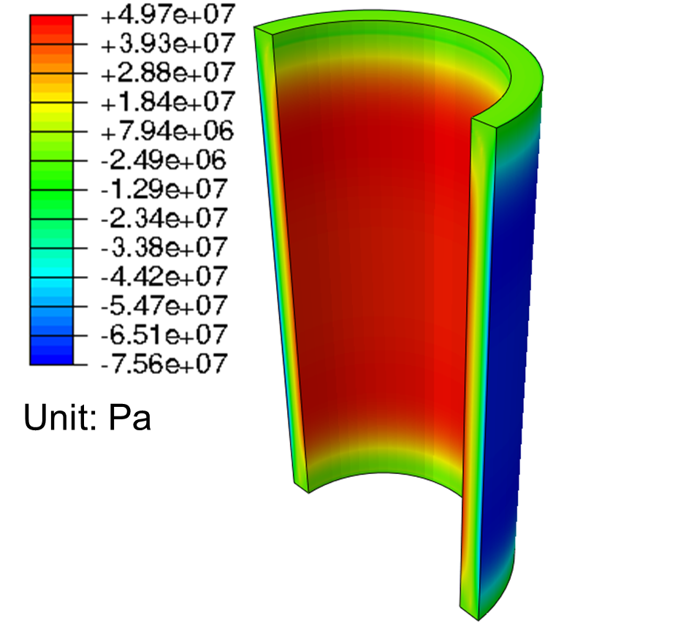
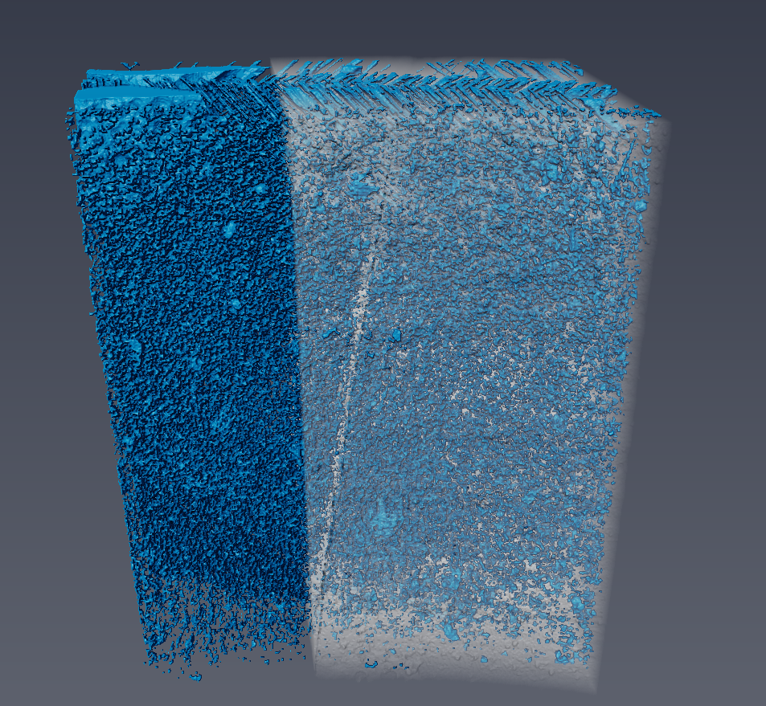
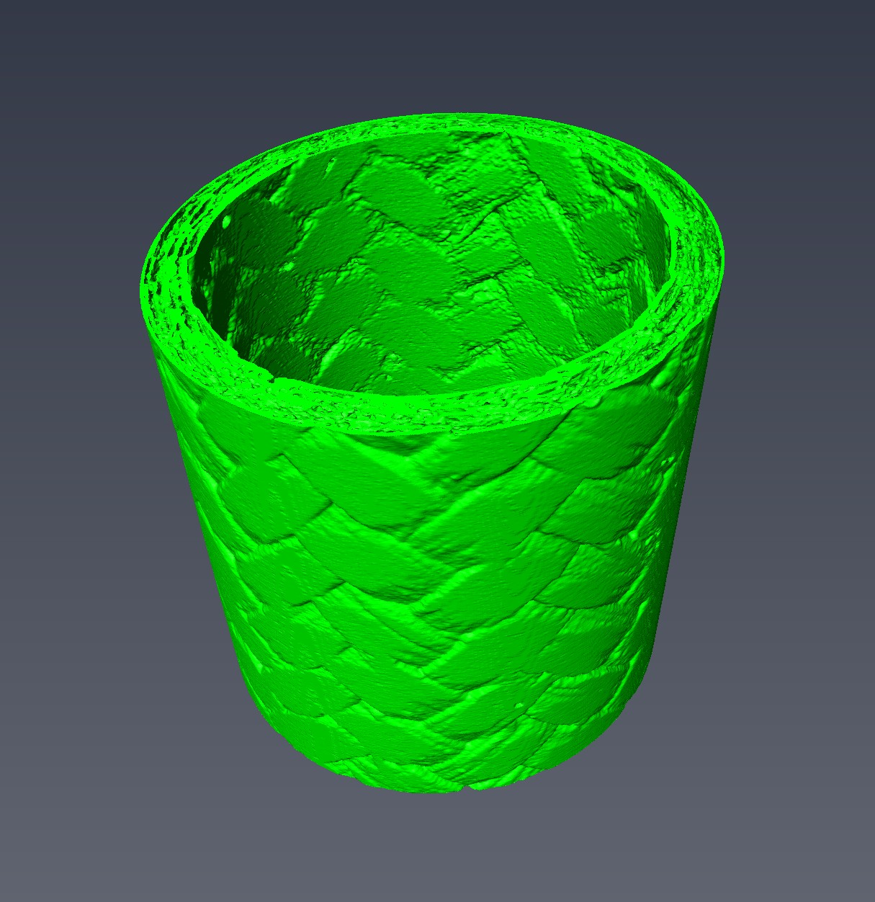
Project approach
Stress state during irradiation with temperature gradient simulated by FEM
Proposed experiment at NSUF
X ray diffraction computed tomography providing lattice strain map
Model validation
X ray computed tomography images showing porosity and radiation-induced cracks
Lattice strain-local microstructure correlation data for model improvement
Porosity map

Slide 7
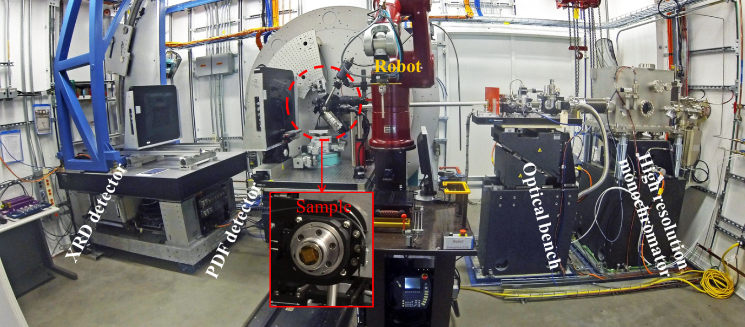
NSUF facility: NSLS-II XPD Beamline at Brookhaven National Laboratory
New XRD-computed tomography (CT) capability
Rapid acquisition of x-ray data
Testing neutron irradiated specimens

Slide 8
Collaboration with BNL
Applied research for ATF SiC cladding development
Sprouster, JNM 527 (2019) 151798
XRD analysis of radiation creep of SiC
NSUF2
Advanced XRD analysis of irradiated SiC
BNL/Stony brook U. internal proposal
Koyanagi, JNM 521 (2019) 63
Sprouster, Scripta 137 (2017) 132
XRD-CT of irradiated SiC tube for model validation
NSUF2 (this project)
Evaluation of radiation defects in SiC
BNL/Stony brook U. internal proposal
Fundamental material science

Slide 9
Experimental procedure
Irradiation of SiC composite tubes in HFIR
Shipment of the specimens to BNL
XRD-CT and analysis at BNL
Comparison of XRD-CT data (lattice strain map) and model result
Comparison of XRD-CT data and XCT microstructure
SiC tube
SiC thermometry
Mo heater

Slide 10
Irradiation under a high radial heat flux in HFIR
General Atomics SiC/SiC tubes
OD:8.5, ID: 7.1, Length:16 (mm)
LWR relevant heat flex of ~0.7MW/m² produced by Mo heater
(gamma absorbing cylinder)
Target outer surface T: 300-350°C
Neutron dose of 2.3dpa
Petrie et al., JNM 491 (2017) 94-104

Slide 11
Expected stress state of SiC/SiC cladding
Thermal expansion stress
Hot
(e.g. Fuel)
Cold
(e.g. Coolant)
Swelling induced stress
Negative temperature-dependence of swelling
~100MPa in tension with ~150°C gradient
Tension
Compression

Slide 12
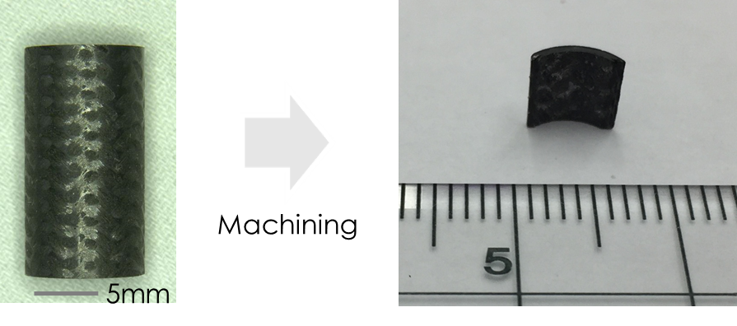
Plan of XRD-DT experiment
Specimen type | Nominal neutron damage [dpa] | Irradiation Temperature (inner surface) [ºC] | Irradiation temperature (outer surface) [ºC] | Through-thickness temperature gradient [ºC]
Chemical-vapor-infiltrated SiC/SiC composites fabricated by General Atomics | 0 | Unirradiated
 | ~2 | ~470 | ~320 | ~150
 | ~2 | ~480 | ~330 | ~150
 | ~2 | ~470 | ~320 | ~150
2-year project
6 days of beam time (3 days per year)
Spatial resolution of the XRD-CT :~30 μm (set by the beam size)
XRD-CT scan time: at least 8–10 hours per sample
Machining relieves residual stress due to swelling gradient, but permanent lattice expansion (swelling) remains.

Slide 13
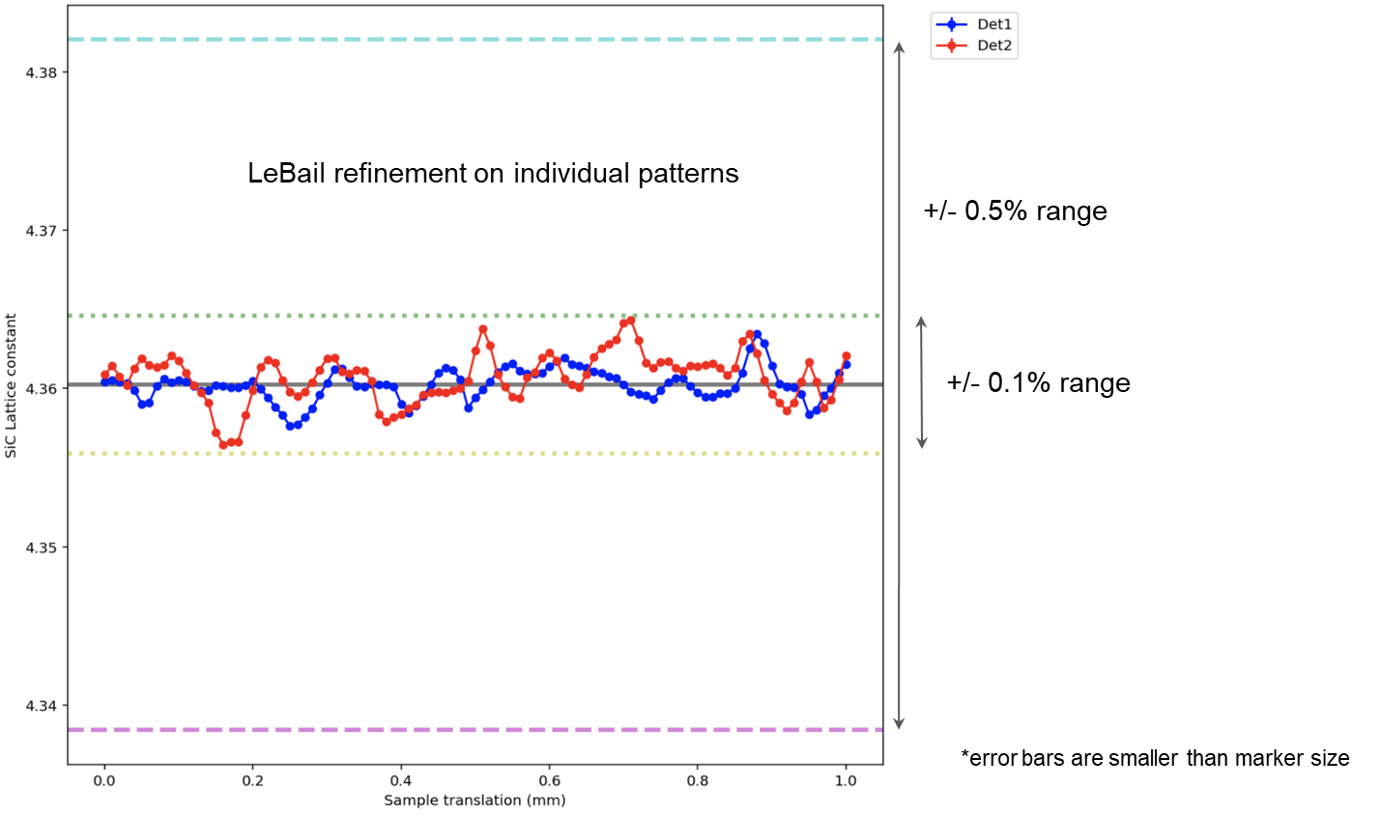
Preliminary XRD-CT experiment using reference SiC
Sample is line scanned for a distance
of 1mm with 10 micron step size (100 steps)
Courtesy of Mehmet Topsakal at BNL

Slide 14
XRD peak profile analysis
Sprouster, Scripta 137 (2017) 132
Previous PI’s study developed procedure of XRD peak profile analysis
Rietveld refinement
Identification of Stacking fault peak (the effect of processing defects)
The volume expansion quantified from the XRD analysis was very similar to the macroscopic swelling measurements following irradiation
Modification of lattice constant by irradiation
Atomistic defects causing lattice expansion (swelling)
Irradiation creep: ignoble compared with swelling
Stress due to swelling gradient

Slide 15
FEA simulation of irradiation temperature and stress state after irradiation
Petrie, JNM 491 (2017) 94
Unit: °C
A simple FEA model considering SiC composite as a uniform bulk material
Time-dependent thermo-mechanical properties considered
Stress cased by temperature dependent swelling across the tube thickness
=> Quantitative validation required by XRD data

Slide 16
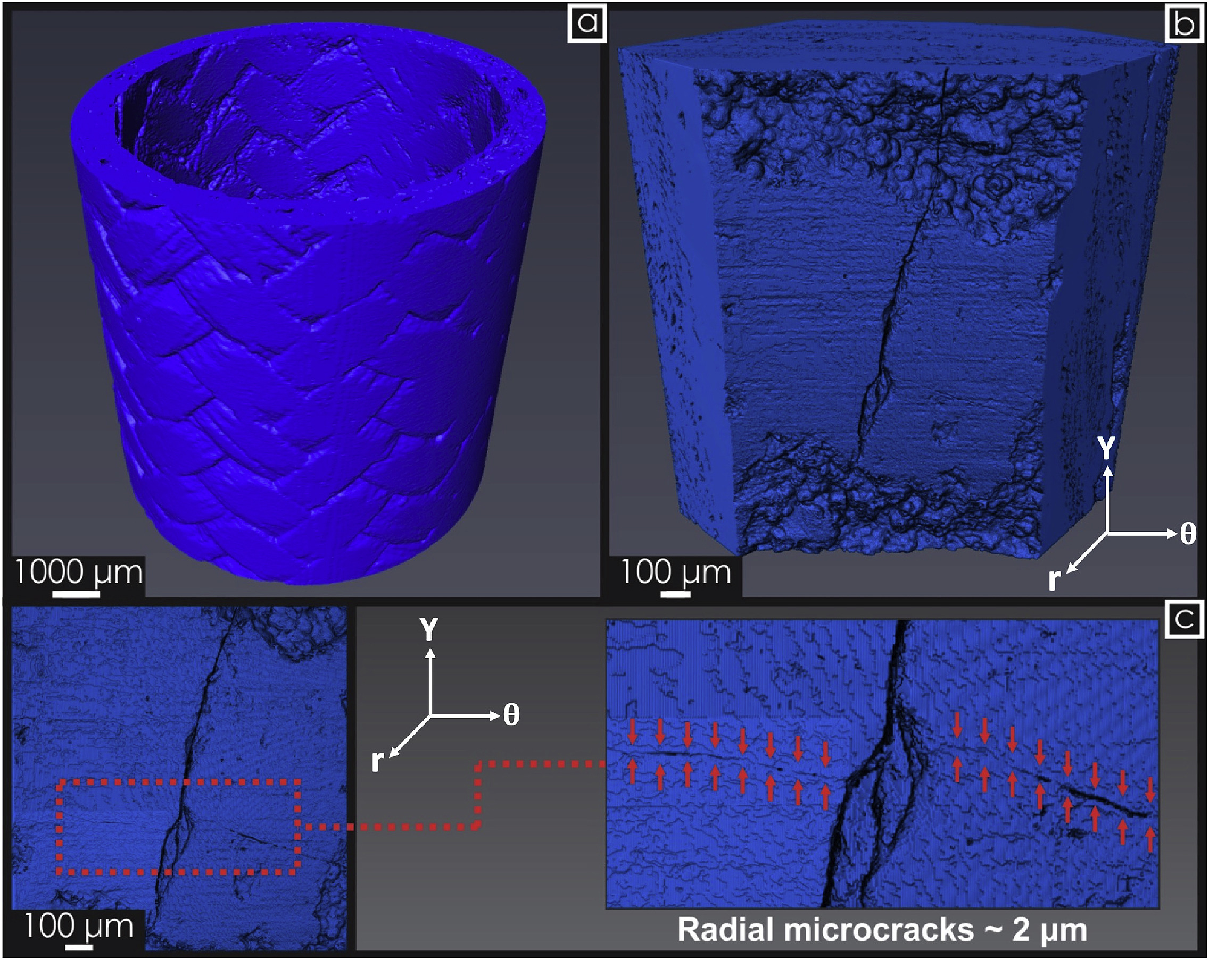
XCT of irradiated SiC tubes
XCT experiment was conducted at ORNL
Testing three different irradiated tubes will provide understanding of how local microstructure affects the lattice strain, because each specimen will possess a unique microstructural feature such as pores or cracks.

Slide 17
Project approach
Stress state during irradiation with temperature gradient simulated by FEM
Proposed experiment at NSUF
X ray diffraction computed tomography providing lattice strain map
Model validation
Complete
Under specimen preparation for shipment to BNL
X ray computed tomography images showing porosity and radiation-induced cracks
Lattice strain-local microstructure correlation data for model improvement
Complete
Porosity map

Slide 18
Project schedule
This project will be carried out over a 24-month (2-year) period.
Shipment of the test specimens to BNL within 3 months from project initiation
XRD-CT experiment on one unirradiated and one irradiated SiC/SiC tube (3 days of beam time in Year 1 starting on Oct 2020) and optimization of the data processing
XRD-CT experiment on two irradiated SiC/SiC tubes (3 days of beam time in Year 2)
Analysis of the XRD-CT data by comparison with the simulation results and conventional XCT images (Years 1 and 2)

Slide 19
Project deliverables and expected outcomes
Dates | Deliverable | Completion Date
Year 1 | XRD-CT lattice strain maps of unirradiated and irradiated SiC tubes (one specimen each) | 12 months from project initiation
Year 2 | NSUF final report Registration of the material data for NSUF fuel and material library | 24 months from project initiation
Journal publication of the results is planned
The research findings will be shared and discussed with General Atomics, an official collaborator in the ATF program and material provider for improvement of the material performance

Slide 20
Summary
The overarching goal of the proposed project is to experimentally verify the modeling results of a SiC-based fuel clad subject to neutron irradiation under high radial heat flux, which is relevant to practical LWR fuel operation.
This project is intended to obtain critical experimental data that can be directly overlaid and compared with the modeling results. The proposed work will conduct XRD-CT analysis of neutron irradiated SiC tubes in the NSLS-II XPD Beamline at BNL.
The 2D and/or 3D distribution of lattice strain within the neutron-irradiated SiC/SiC composite tubes will be obtained. This experimental result will be compared with simulated lattice strains conducted in our previous work. In addition, the lattice strain distribution and conventional XCT microstructure will be overlaid so that the effects of local microstructure on lattice stress will be understood.

Slide 21
Acknowledgements
PI support, neutron irradiation experiment, and modeling effort: US. DOE NE, Advanced Fuels Campaign under contact DE-AC05-00OR22725 with ORNL, managed by UT Battelle, LLC
NSUF access: DOE NE under DOE Idaho Operations Office Contract DE-AC07- 051D14517
NUSF technical support: Lynne Ecker and Mehmet Topsakal
National Synchrotron Light Source-II: DOE Office of Science User Facility operated for the DOE Office of Science by Brookhaven National Laboratory under Contract No. DESC0012704.
HFIR: DOE Office of Science User Facility operated by ORNL
Fabrication of tube specimens: General Atomics

