Slide 1




Machine Learning on High-Throughput Databases of Irradiation Response and Corrosion Properties of Selected Compositionally Complex Alloys for Structural Nuclear Materials
Dane Morgan, Adrien Couet, Dan Thoma
(University of Wisconsin – Madison, WI USA)
Mukesh Bachhav
(Idaho National Laboratory, ID USA)
Nuclear Science User Facilities
FY 2020 Annual Program Review (Nov. 10-11, 2020)
Virtual via BlueJeans
November 10, 2020
Notes:
35m = 30m+5 m

Slide 2

Funding Acknowledgements
Department of Energy NEUP Project 20-19128 with NSUF access

Slide 3
Outline
Project Overview
Specific Tasks
Present Status

Slide 4
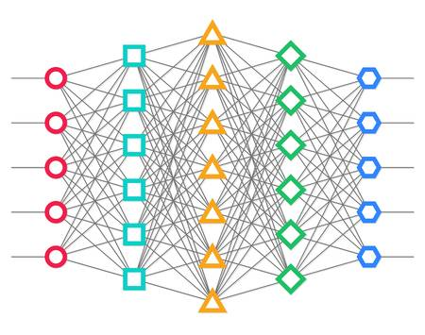

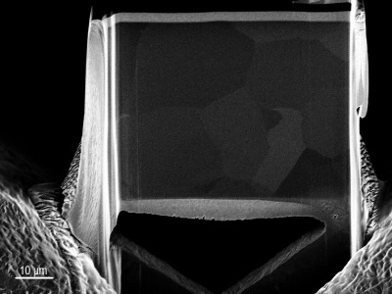
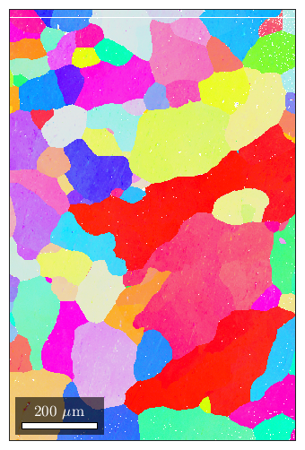
Project Overview
Alloy processing
(UW Couet/Thoma)
Powder Hoppers
Cr
Fe
Mn
Ni
Auger
Nozzle
Machine learning
(UW Morgan)
Laser
Ion irradiation
(UW Couet)
Flow Gas
Part
Build Plate
Argon
Ion beam
Regression, Feature extraction
2D stage
Profilometry
Simulated features
(UW Morgan)
Nano-hardness
HT characterization (UW/INL Couet/Thoma/Bachhav)
XRD
EBSD/EDS
Ab initio
Cluster dynamics
Selected detailed characterization (INL Bachhav)
APT
TEM
EBSD
Notes:
NN image: https://www.123rf.com/clipart-vector/neural_network.html?sti=ndiy8fzoirauoxy0ie|&mediapopup=62610989
Circular arrows from: https://www.officetooltips.com/powerpoint_2016/tips/how_to_create_a_cycle_flow_chart_using_four_arrows_in_a_circle.html

Slide 5
Materials Systems
Diao, et al. COSSMS ‘17
Focus on Compositionally Complex Alloys (CCAs) because
  Potentially outstanding mechanical properties.
  Large space of poorly or unknown radiation and corrosion response.
  Compositional space challenging to explore with traditional approaches –a high-throughput opportunity.
FeCrMnNi (fcc): Model for traditional stainless steels; validation and exploration of Mn.
FeCrMoNi (fcc): Similar to Hastelloy; molten salt reactors.
MoNbTiV (bcc): Extreme environment refractory; single phase region and existing data.
MoNbTaW (bcc): Extreme environment refractory; exceptional high-temperature strength.

Slide 6
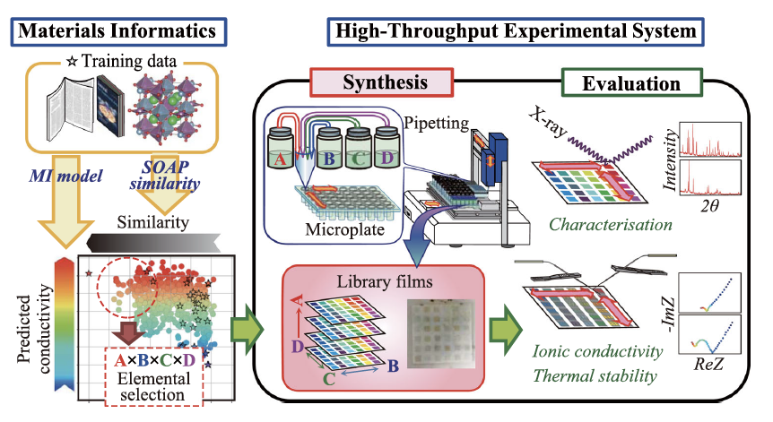
Potential Impact
Unprecedented database of irradiation and corrosion behavior of CCAs (~400 compositions).
New understanding and predictive models for CCA irradiation and corrosion behavior.
A foundational example of the combinatorial and high-throughput methodology (CHT) methodology in structural nuclear materials.
Ambitious, but beginning to work in other fields…
M. Matsubara, et al., Comm. Mat. ‘20
Designed a novel [Ca_{x}(Nb_{0.6}Ta_{0.4})_{1−x}]_{1−z}Bi_{z}O_{δ} superionic conductor.

Slide 7
Outline
Project Overview
Specific Tasks
Present Status

Slide 8
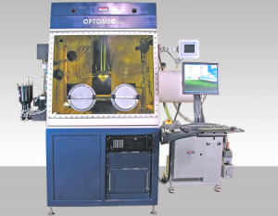
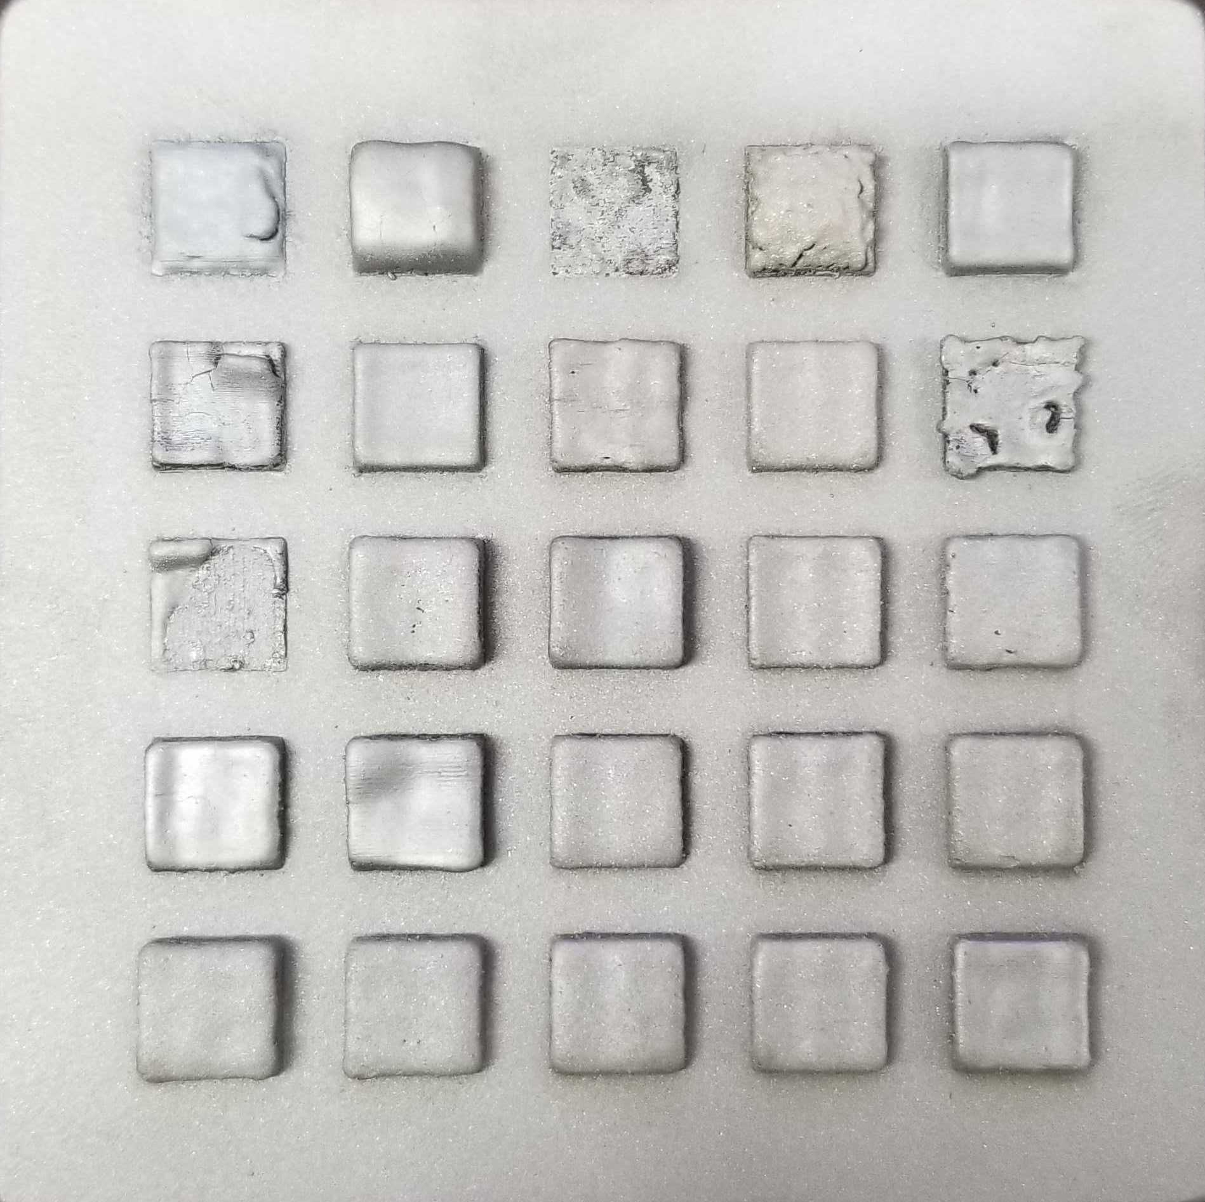
High-Throughput Alloy Processing
Powder Hoppers
High-throughput synthesis with a LENS MR-7.
Up to 4 powders can be combined to together to rapidly make dozens of compositions.
Flexible printing geometries support later characterization
Cr
Fe
Mn
Ni
Auger
Nozzle
Laser
Part
Flow Gas
Build Plate
Argon
10cm
M. Moorehead, Mat and Des. ’20; submitted ‘20

Slide 9
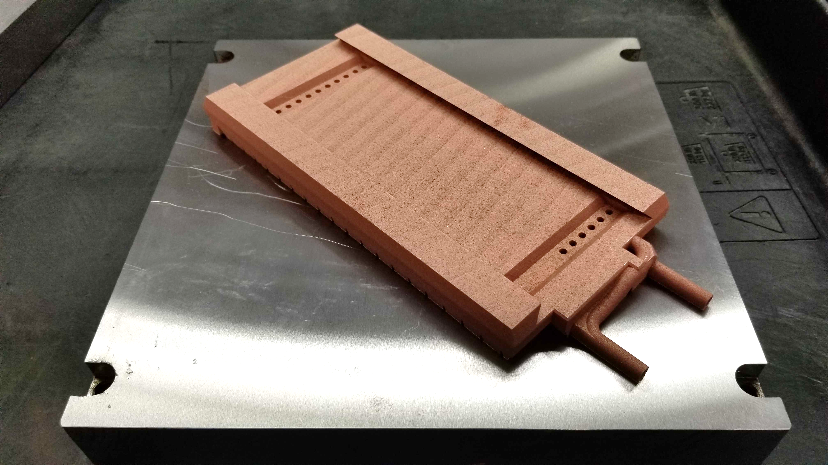
High-Throughput Ion Irradiation
Ion beam
UW Ion Beam Laboratory (IBL), NSUF facility.
Novel 2D stage with automated XY positioning.
High-power laser system with thermocouple and optical temperature measurements.
Highly controlled location, temperature, flux/fluence
2D stage

Slide 10
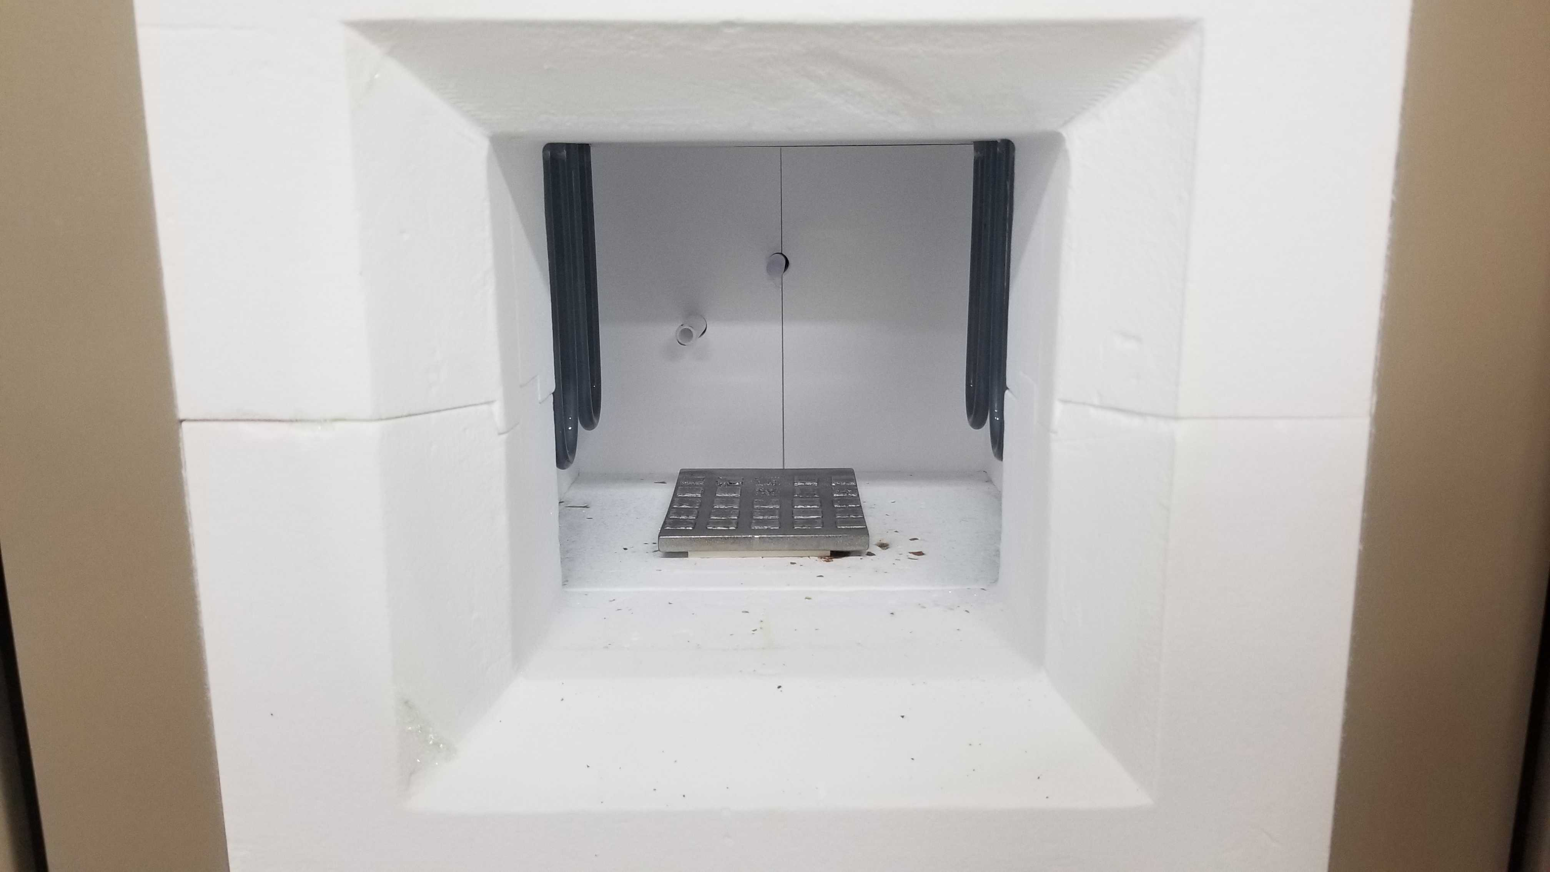
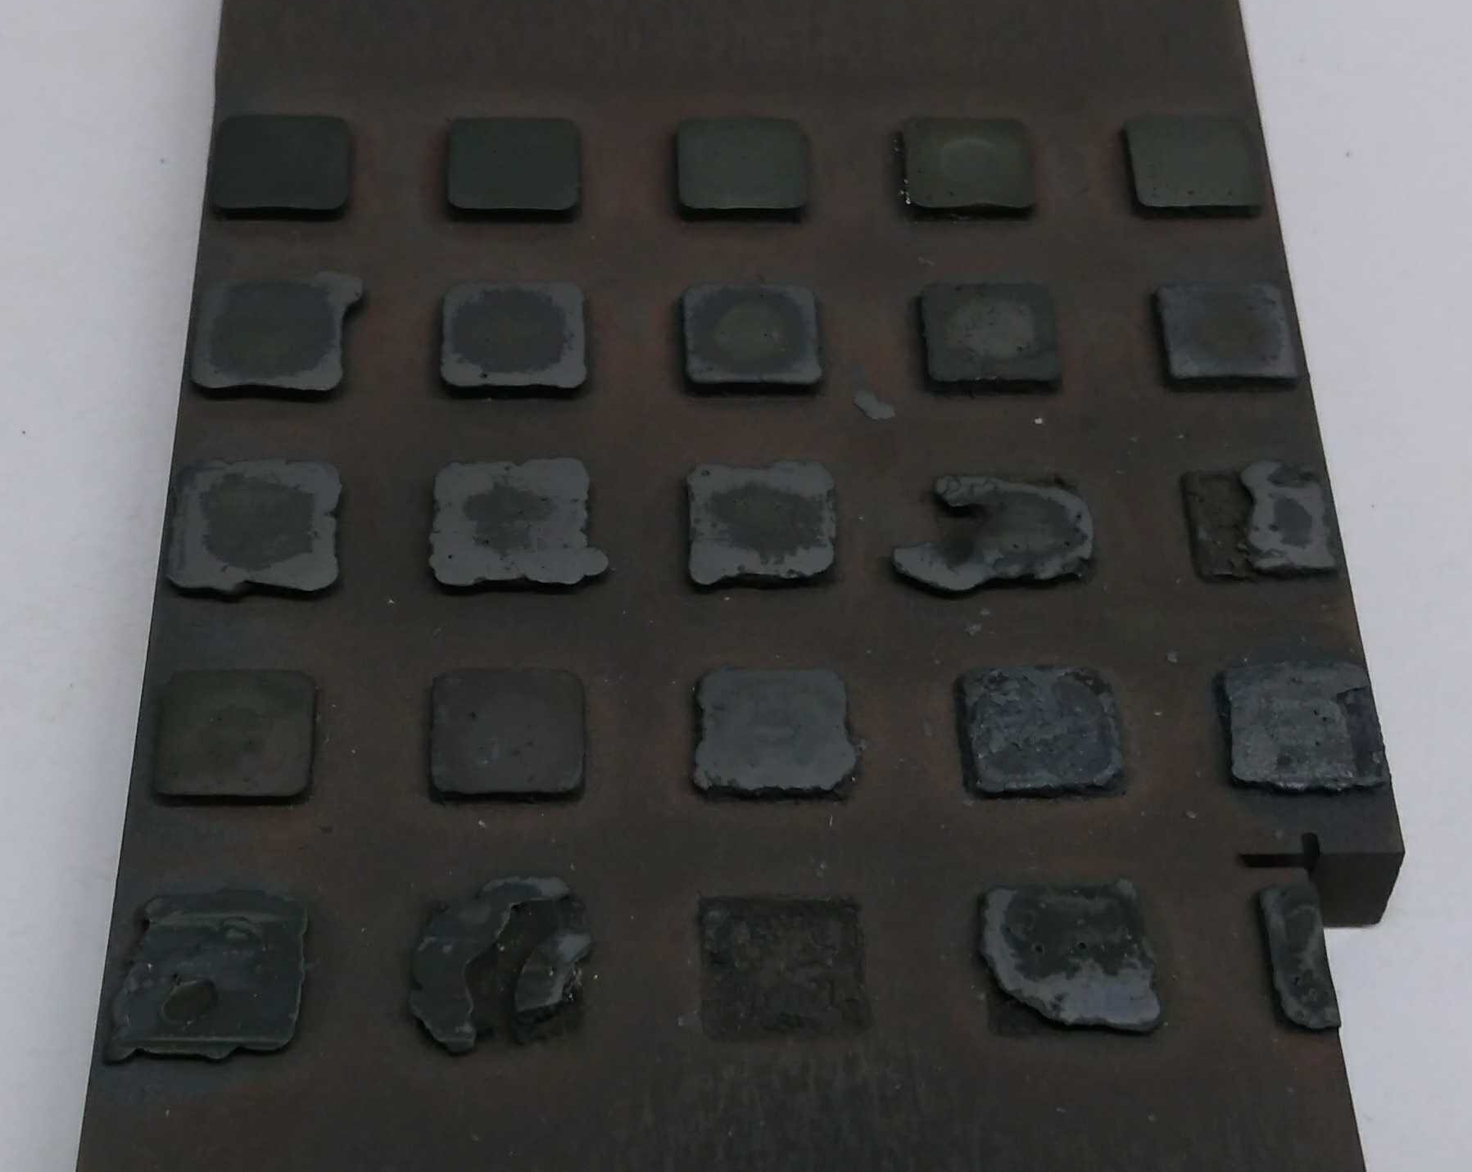
High-Throughput Corrosion
Corrosion laboratory at UW has essential environmental control (temperature, PO₂).
Expose partially masked plates to high-temperature air conditions for controlled corrosion.
FeCrMnNi additively printed samples in the high temperature furnace
FeCrMnNi additively printed samples oxidized in synthetic air at 850°C for 5 hours

Slide 11
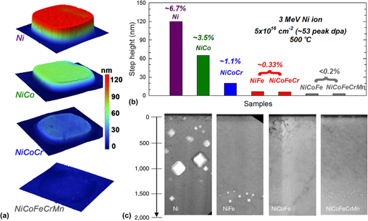
High-Throughput Characterization of Radiation/Corrosion Effects
General
  XRD For phase changes (e.g., radiation enhanced/induced, corroded oxide)
  EDS, XRF for composition
Irradiation
  Profilometry for swelling
  Nano-hardness for embrittlement
Corrosion
  Plasma FIB and built in EBSD and EDS for oxide characterization of corroded specimens.
M. Moorehead, Mat and Des. ‘20
C. Lu, et al. Nature Comm. ‘16
Notes:
Lu, C., Niu, L., Chen, N., Jin, K., Yang, T., Xiu, P., Zhang, Y., Gao, F., Bei, H., Shi, S., He, M. R., Robertson, I. M., Weber, W. J., & Wang, L. (2016). Enhancing radiation tolerance by controlling defect mobility and migration pathways in multicomponent single-phase alloys. Nature Communications. https://doi.org/10.1038/ncomms13564

Slide 12
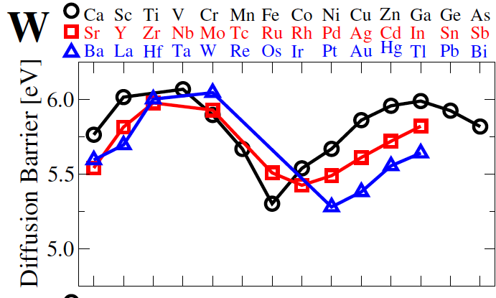
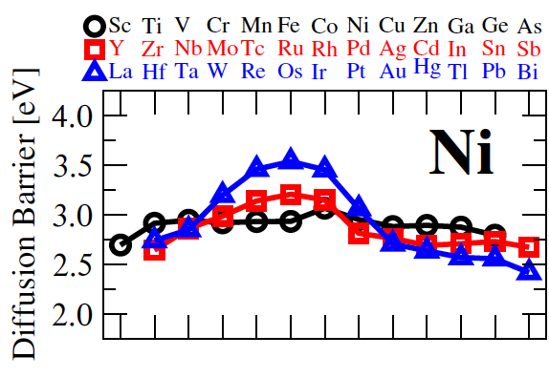
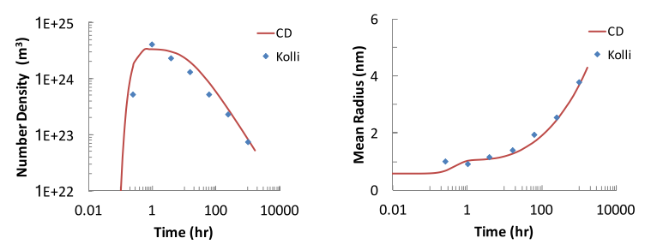
High-Throughput Simulated Features
Ab initio methods can rapidly simulate basic controlling thermo-kinetic parameters (e.g., migration barriers).
Mesoscale simulations can predict qualitative rates of key processes (e.g., void growth).
Simulated data can provide features for machine learning correlations.

Slide 13
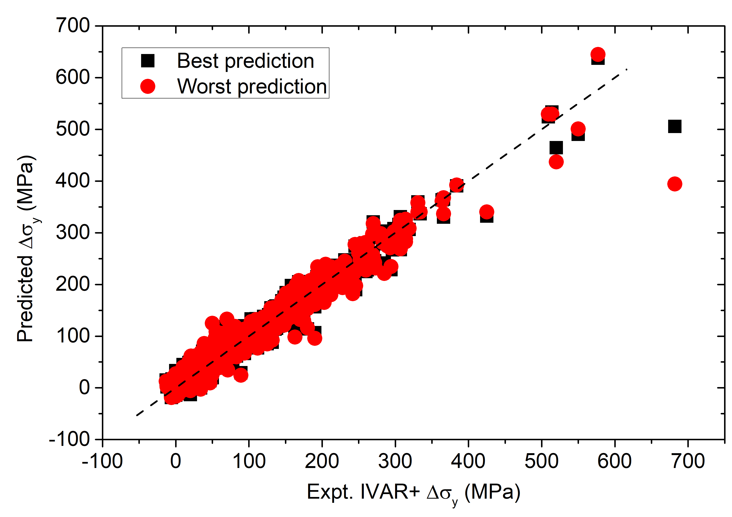
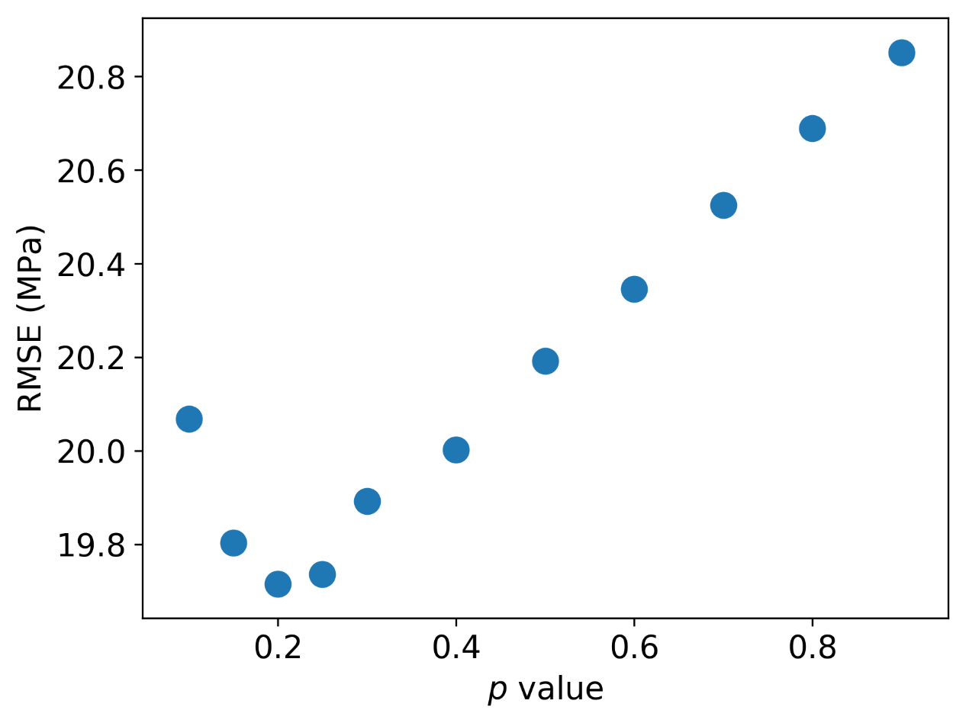
Machine Learning
Fit measured properties, (e.g., swelling, oxide thickness) vs. features (e.g., elemental properties, radiation conditions)
Use machine learning methods for robust regression, e.g., boosted trees.
Goal is locally predictive models (e.g., interpolation in composition) and identifying important features.
F. Garner and H.R. Brager, Eff. Radiat. Mater. Twelfth Int. Symp. ‘85
Y.-C. Liu, Submitted ‘20

Slide 14
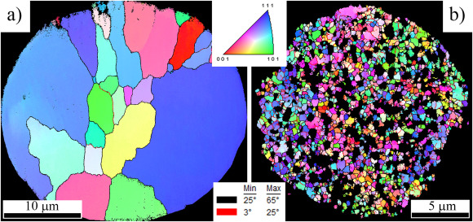
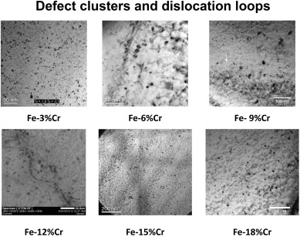
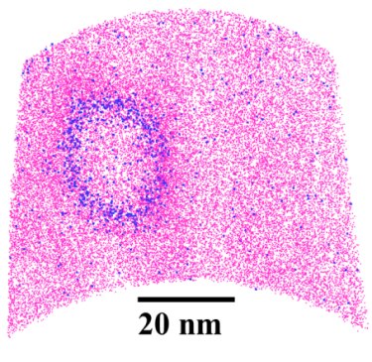
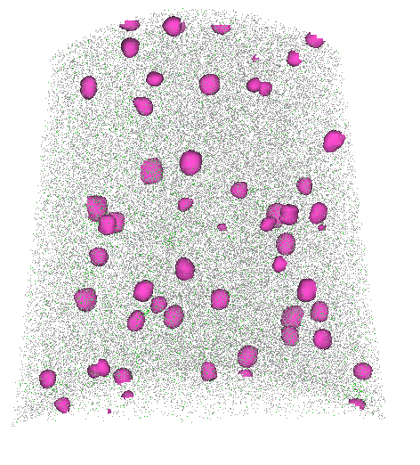
Detailed Characterization
EBSD
TEM
APT
Fe-6Cr
Cr
Si
Fe-15Cr
Unirradiated Irradiated U-Mo fuel particle
20 nm
D. Jadernas, JNM ‘18
Bachhav, JNM ‘14; Bhattacharyya, JNM ‘19
Utilize low-throughput focused-ion beam and atom probe tomography (FIB+APT) and electron microscopy (FIB+STEM) for detailed characterization of radiation effects (precipitates, loops, voids, …) and composition (EELS).
Utilize medium-throughput FIB+(EBSD, EDS, BES) for detailed characterization of grain structure and compositions.
Includes ability to perform serial sectioning and 3D reconstruction.

Slide 15
NSUF Facilities Use
INL High Performance Computing Resources for materials modeling and data analytics
INL Irradiated Materials Characterization Laboratory (IMCL) for Post Irradiation Examination (PIE) with Plasma Focused Ion Beam (FIB), X-ray diffraction (XRD) and (scanning) transmission electron microscopy (S/TEM) on selected samples.
INL Center for Advanced Energy Studies (CAES) for atom probe tomography (APT).
UW Ion Beam Laboratory (IBL) for irradiations.
UW Characterization Laboratory for Irradiated Materials (CLIM) for scanning electron microscopy (SEM) and energy dispersion spectroscopy (EDS).

Slide 16
Outline
Project Overview
Specific Tasks
Present Status

Slide 17
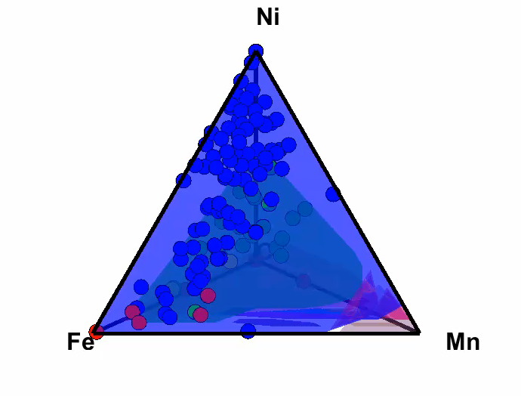
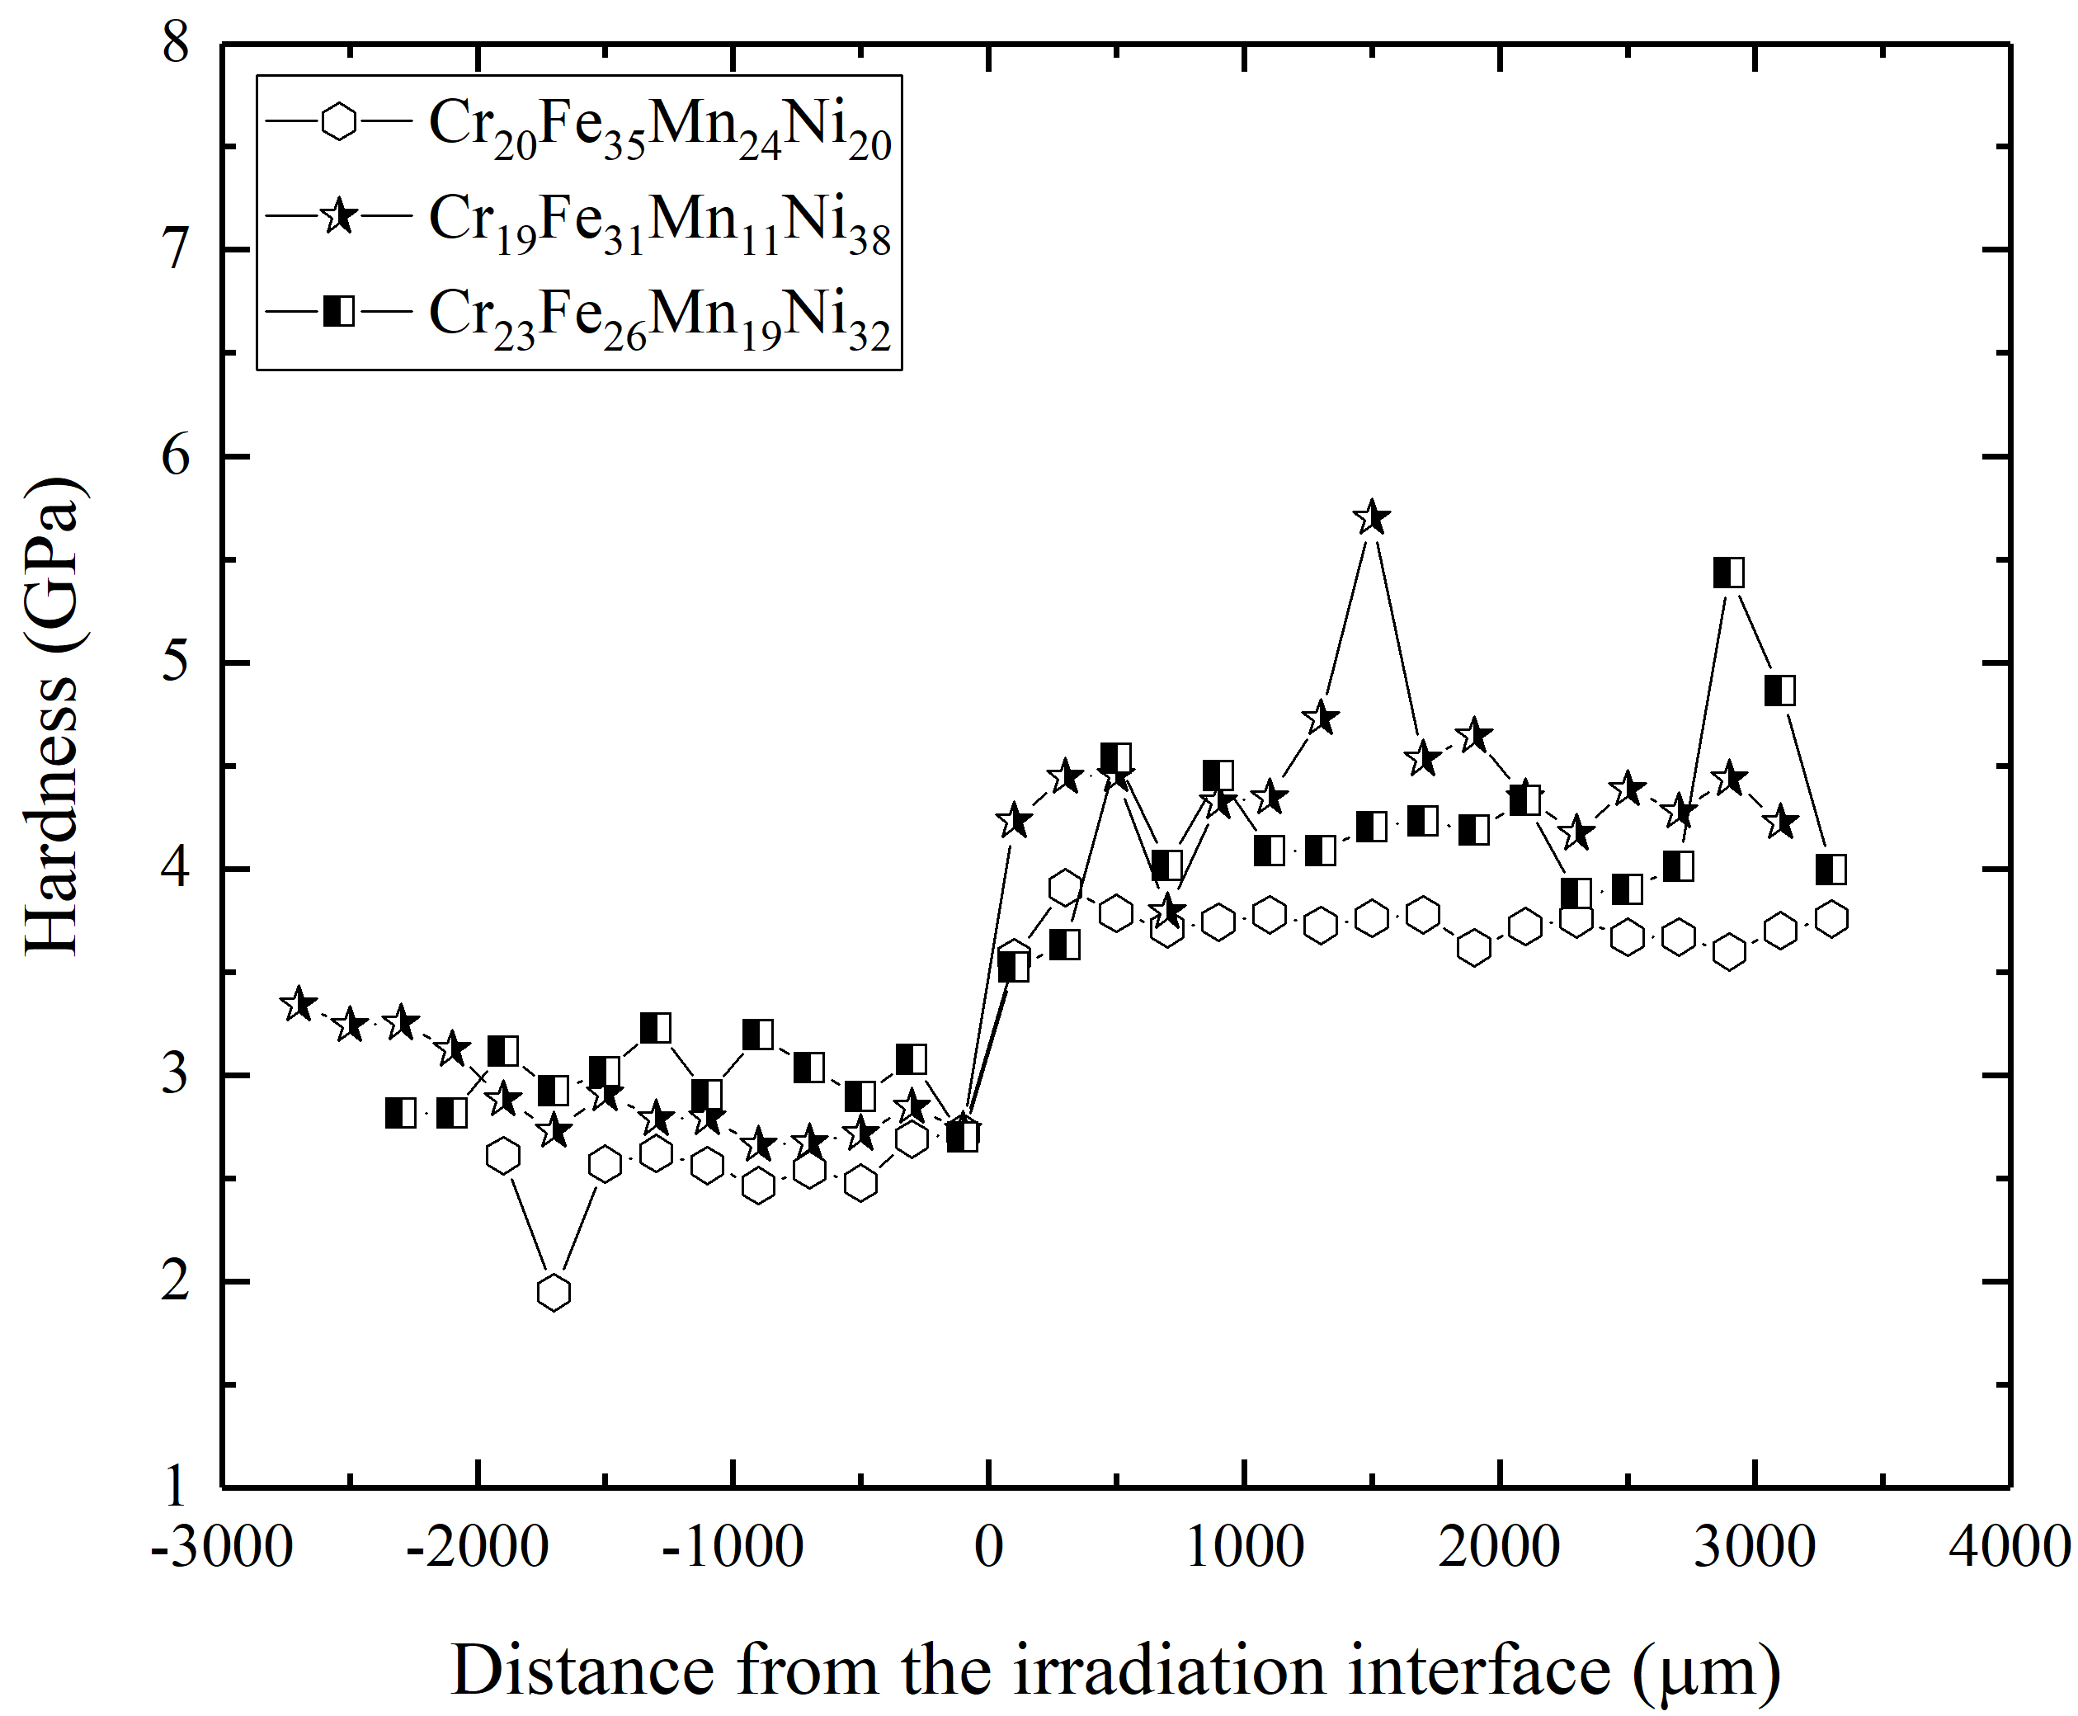
Present Status
High-throughput processing, irradiation, and some characterization is working.
  120 unique Cr-Fe-Mn-Ni compositions
  Hardening observed with nanoindentation
Still many challenges (e.g., controlling porosity)
Still need to refine high-temperature irradiations, high-throughput with FIB+EBSD
Machine learning tools ready but collecting literature data and need proposed measurements to explore efficacy
Unirradiated
Irradiated
M. Moorehead, submitted ‘20

Slide 18
Thank You for Your Attention
Any Questions?

