Slide 1
Investigation of Degradation Mechanisms of Cr-coated Zirconium Alloy Cladding in Reactivity Initiated Accidents (RIA)
FC-2.5 (NSUF Separate Effects Testing in TREAT using Standard Test Capsule)
Department of Energy Number: DE-NE0008961
Project Period: October 2020 – September 2024
Dr. Hwasung Yeom
University of Wisconsin, Madison
NSUF Annual Review Meeting
November 9th – 10th, 2020

Slide 2
Program Directors
Dr. Daniel Wachs
  Technical POC
  Idaho National Laboratory
Dr. Kenneth Kellar
  Federal POC

Slide 3
Project Collaborators
University of Wisconsin, Madison (UW, Lead organization)
  Dr. Hwasung (Sung) Yeom (Lead PI)
  Dr. Kumar Sridharan
  Tyler Dabney (graduate student)
University of Illinois, Urbana-Champaign (UIUC)
  Dr. Brent Heuser
Nuclear Regulatory Commission (U.S. NRC)
  Ms. Michelle Bales
NSUF Technical Lead (INL)
  Mr. David Kamerman

Slide 4
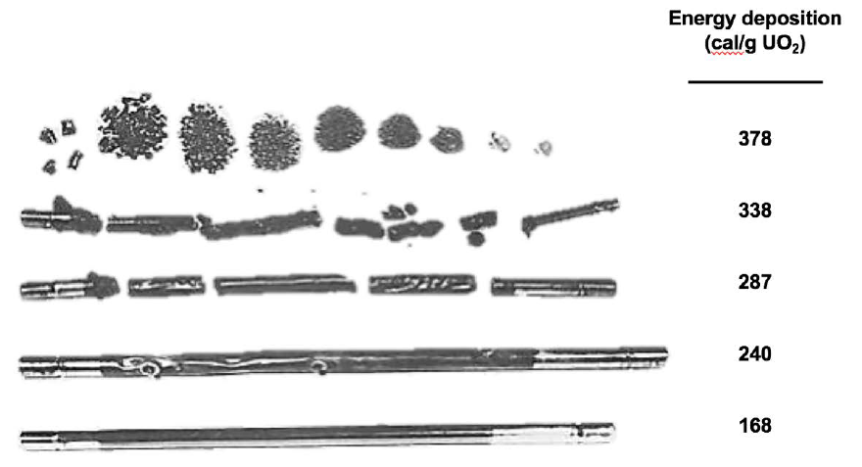
Data Gaps for Response of ATF Cr-coated Zr-alloy Cladding under Power Transient Conditions
Deployment of the near-term ATF fuels in the current U.S. LWR fleet requires demonstration of responses of the ATF designs under postulated DBAs (RIA or LOCA)
Many reports identify data gaps for licensing and several performance criteria of Cr-coated cladding such as:
  Performance above Cr-Zr eutectic temperature (1332 °C)
  Post-quench ductility
  Coating integrity during swelling/rupture
Pictures of failed fuel following RIA testing in SPERT [NUREG-0800]

Slide 5
Project Goal
To investigate thermal, mechanical, and irradiation response of Cr-coated Zr-alloy claddings (cold spray Cr coating and PVD Cr coating) under RIA conditions, in comparison to uncoated Zr-alloy cladding
The proposed TREAT experiment will focus on demonstration of various cladding failure modes at the later phase transient (post-DNB), including ballooning and burst, and high temperature oxidation, or combination thereof

Slide 6
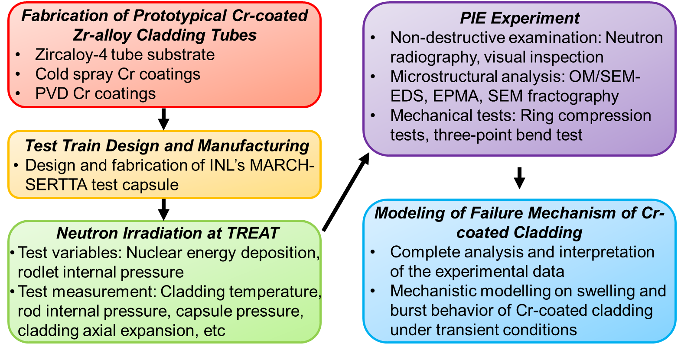
Project Objectives
Objective 1: Sample Fabrication for TREAT Testing
Objective 2: Irradiation capsule design and fabrication
Objective 3: TREAT testing for Cr-coated cladding tubes
Objective 4: Material characterization and mechanical test after TREAT testing
Objective 5: Analysis of data and modeling of failure mechanism of Cr-coated cladding tubes

Slide 7
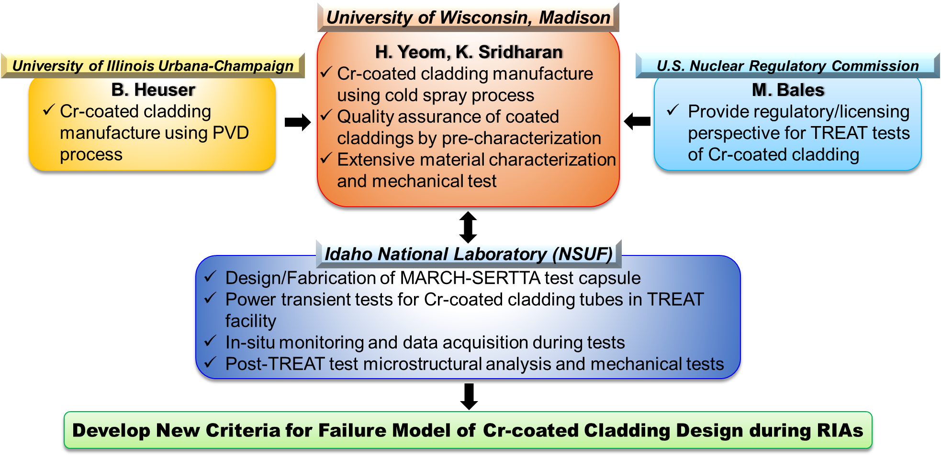
Role of Organizations and Personnel

Slide 8
NSUF Facilities for the Project
The Fuel Fabrication Facilities, INL
  Construction of irradiation test vehicle
The Transient Reactor Test Facility (TREAT), INL
  High energy deposition for a MSERTTA capsule containing a fueled sample
The Hot Fuel Examination Facility (HFEF), INL
  Neutron radiography and mechanical tests
The Irradiated Materials Characterization Laboratory (IMCL) facility, INL
  Capsule deconstruction, visual inspection
  Sample preparation
  Electron microscopy-based characterization

Slide 9
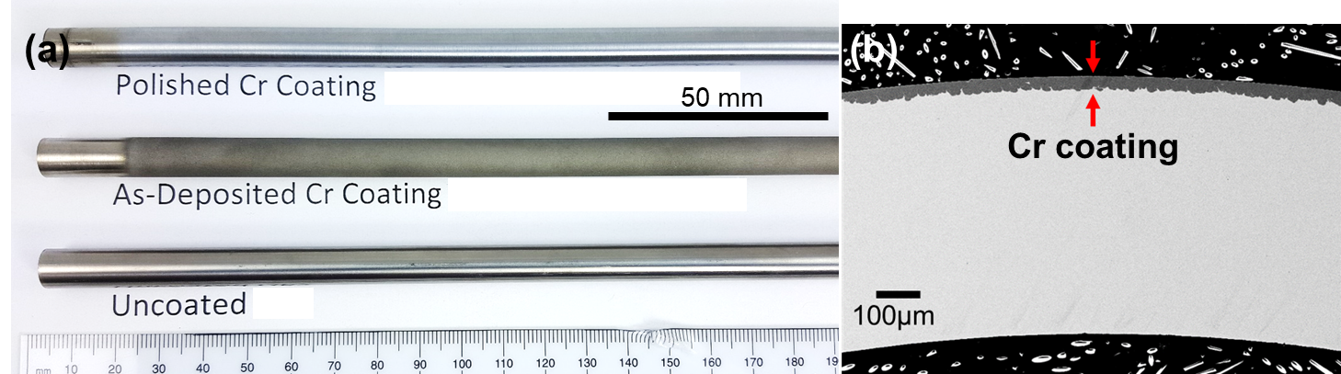
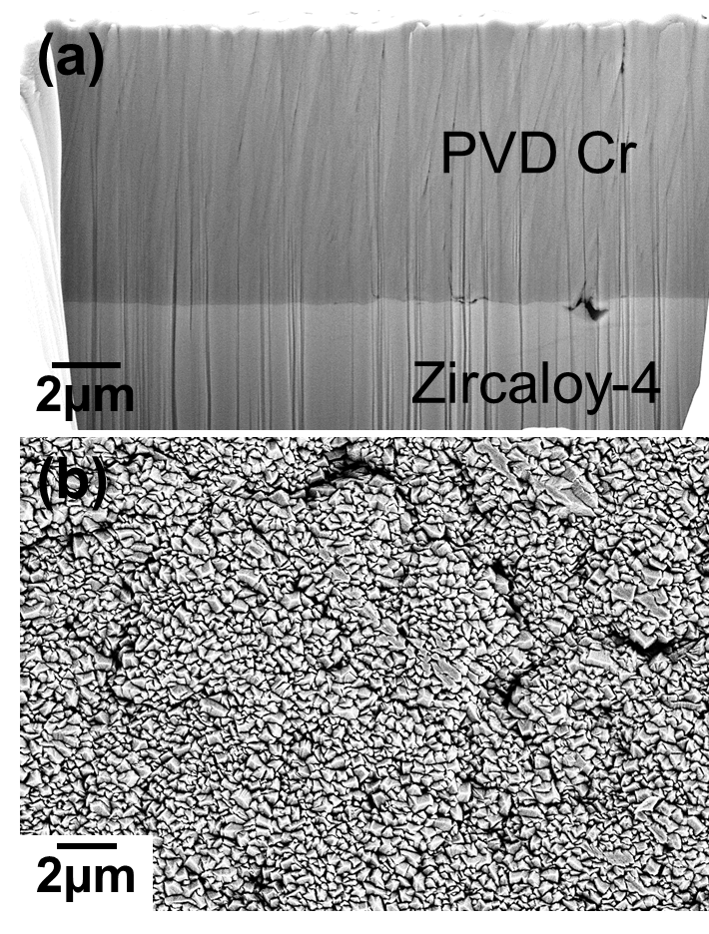
Sample Fabrication for TREAT Testing
Two types of Cr coatings will be investigated in the proposed research:
Those produced by cold spray technology (CST) at UW
Those produced by physical vapor deposition (PVD) process at UIUC
Cr coated Zr-alloy by CST
Cr coated Zr-alloy by PVD
Sample matrix for RIA tests at TREAT facility

Slide 10
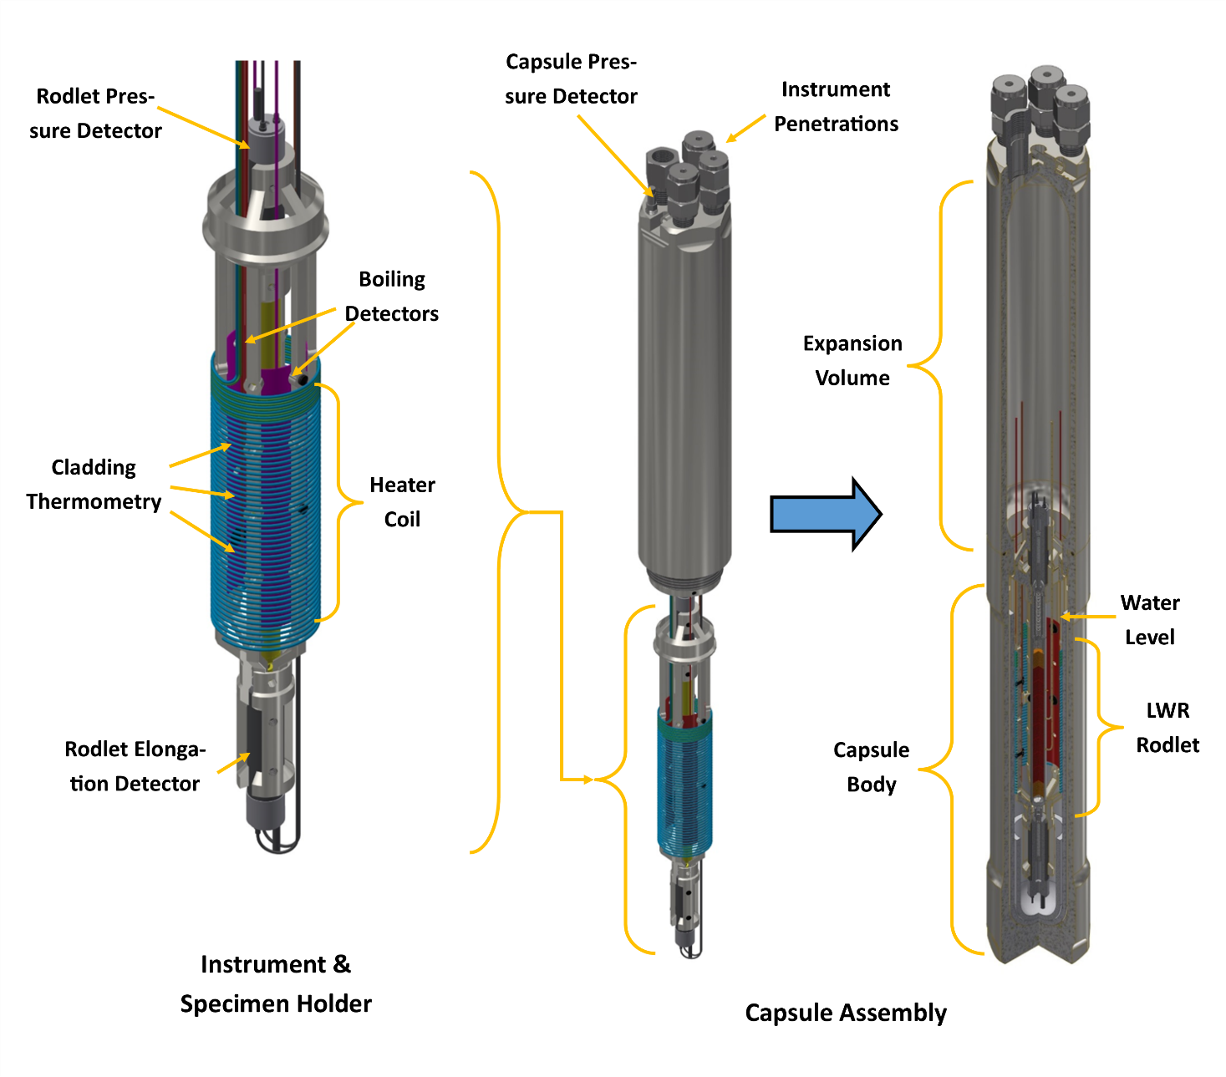
Irradiation Capsule Design and Fabrication
The proposed NSUF-RIA test series will be performed using INL’s MARCH-SERTTA test train
The coated cladding tubes will be loaded with UO2 pellets and endcaps will be welded onto the cladding
On-line monitoring: rod internal pressure, cladding axial expansion, capsule pressure, water temperature, cladding temperature
Test Design | Cladding materials | Cladding total length (mm) | Cladding OD (mm) | Cladding ID (mm) | Pellet Material | Pellet OD (mm)
NSUF-RIA | Zircaloy-4 | 150 | 9.50 | 8.36 | UO₂ | 8.23* (Nominal pellet dimension)
Schematic designs of MARCH-SERTTA experiment module [Kamerman, 2019]
Dimensions of fueled coated cladding samples

Slide 11
TREAT Testing for Cr-coated Cladding Tubes
The irradiation campaign is designed to investigate transient fuel behavior related to cladding ballooning and rupture, melting of cladding, and cladding-coolant interaction
Test ID | Test Purpose | Sample ID | Target PCT (°C) | Estimated Energy Deposition (J/g)* | Rodlet Pressure (MPa) | Anticipated Failure Mechanism
NSUF-RIA-1 | Quantifying eutectic melting, oxidation of CS Cr coating, DNB & film boiling | CS-Cr-Zr-1 | >1332 | 1000 | 0.1 | Partial melting due to Cr/Zr eutectic
NSUF-RIA-2 | Effect of Cr diffusion on ballooning & burst response in CS coating | CS-Cr-Zr-2 | <1200 | 850 | 2 | Ballooning and Burst
NSUF-RIA-3 | Effect of Cr/Zr eutectic melting on ballooning & burst behavior in CS coating | CS-Cr-Zr-3 | 1332<T<1800 | 1000 | 2 | Ballooning and Burst + Partial melting
NSUF-RIA-4 | CS Cr coated cladding melting | CS-Cr-Zr-4 | >1800 | 1300 | 2 | Ballooning and Burst + Extensive melting
NSUF-RIA-5 | Quantifying eutectic melting, oxidation of PVD Cr coating, DNB & film boiling | PVD-Cr-Zr-1 | >1332 | 1000 | 0.1 | Partial melting due to Cr/Zr eutectic
NSUF-RIA-6 | Effect of Cr diffusion on ballooning & burst response in PVD coating | PVD-Cr-Zr-2 | <1200 | 850 | 2 | Ballooning and Burst
NSUF-RIA-7 | Effect of Cr/Zr eutectic melting on ballooning & burst behavior in PVD coating | PVD-Cr-Zr-3 | 1332<T<1800 | 1000 | 2 | Ballooning and Burst + Partial melting
NSUF-RIA-8 | PVD Cr coated cladding melting | PVD-Cr-Zr-4 | >1800 | 1300 | 2 | Ballooning and Burst + Extensive melting

Slide 12
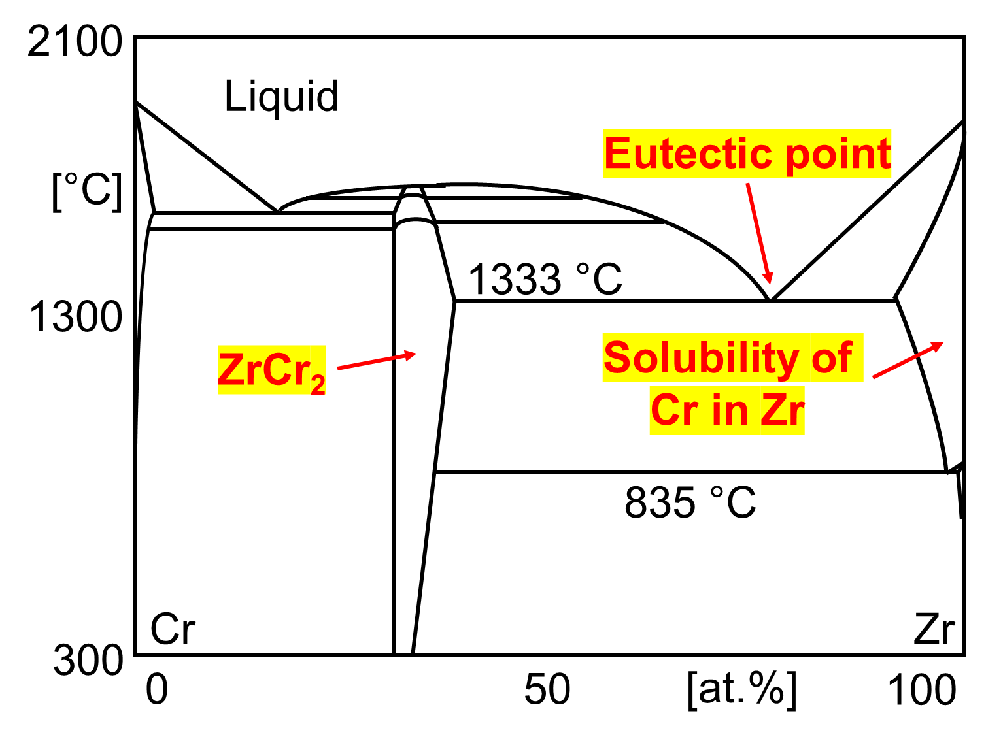
Hypothetical Response of Cr-coated Claddings in RIA Tests
In this late phase transient, it is difficult to anticipate the failure modes due to the multifactorial effects of Cr coating
The Cr coatings mitigates cladding-coolant interaction (i.e., oxidation of cladding OD)
Adhesion strength at coating/substrate interface would be changed by Cr-Zr intermetallic compound formation
Mechanical properties of the coated cladding would be altered by Cr-Zr interdiffusion and partial melting
Rewetting behavior of coated cladding are different from uncoated Zr-alloy due to evolution of surface characteristics
Cr-Zr binary phase diagram redrawn from published data [K. Zeng, 1993]

Slide 13
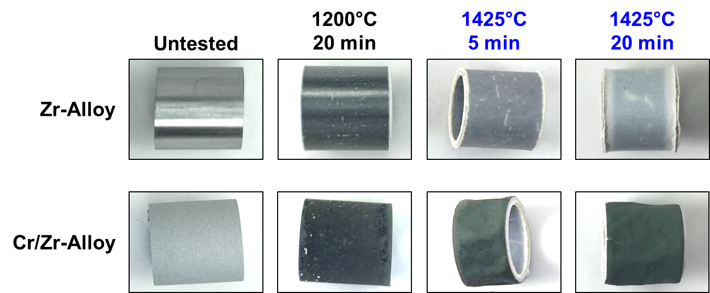
Morphology of Cr-coated ZIRLO® Tubes at Flowing Steam (above Cr/Zr Eutectic Point)
Geometric change of a Cr-coated Zr-alloy tube at the high temperature

Slide 14
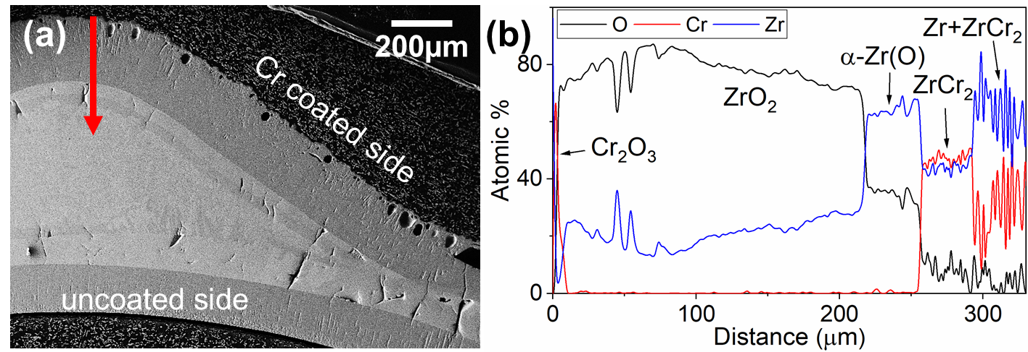
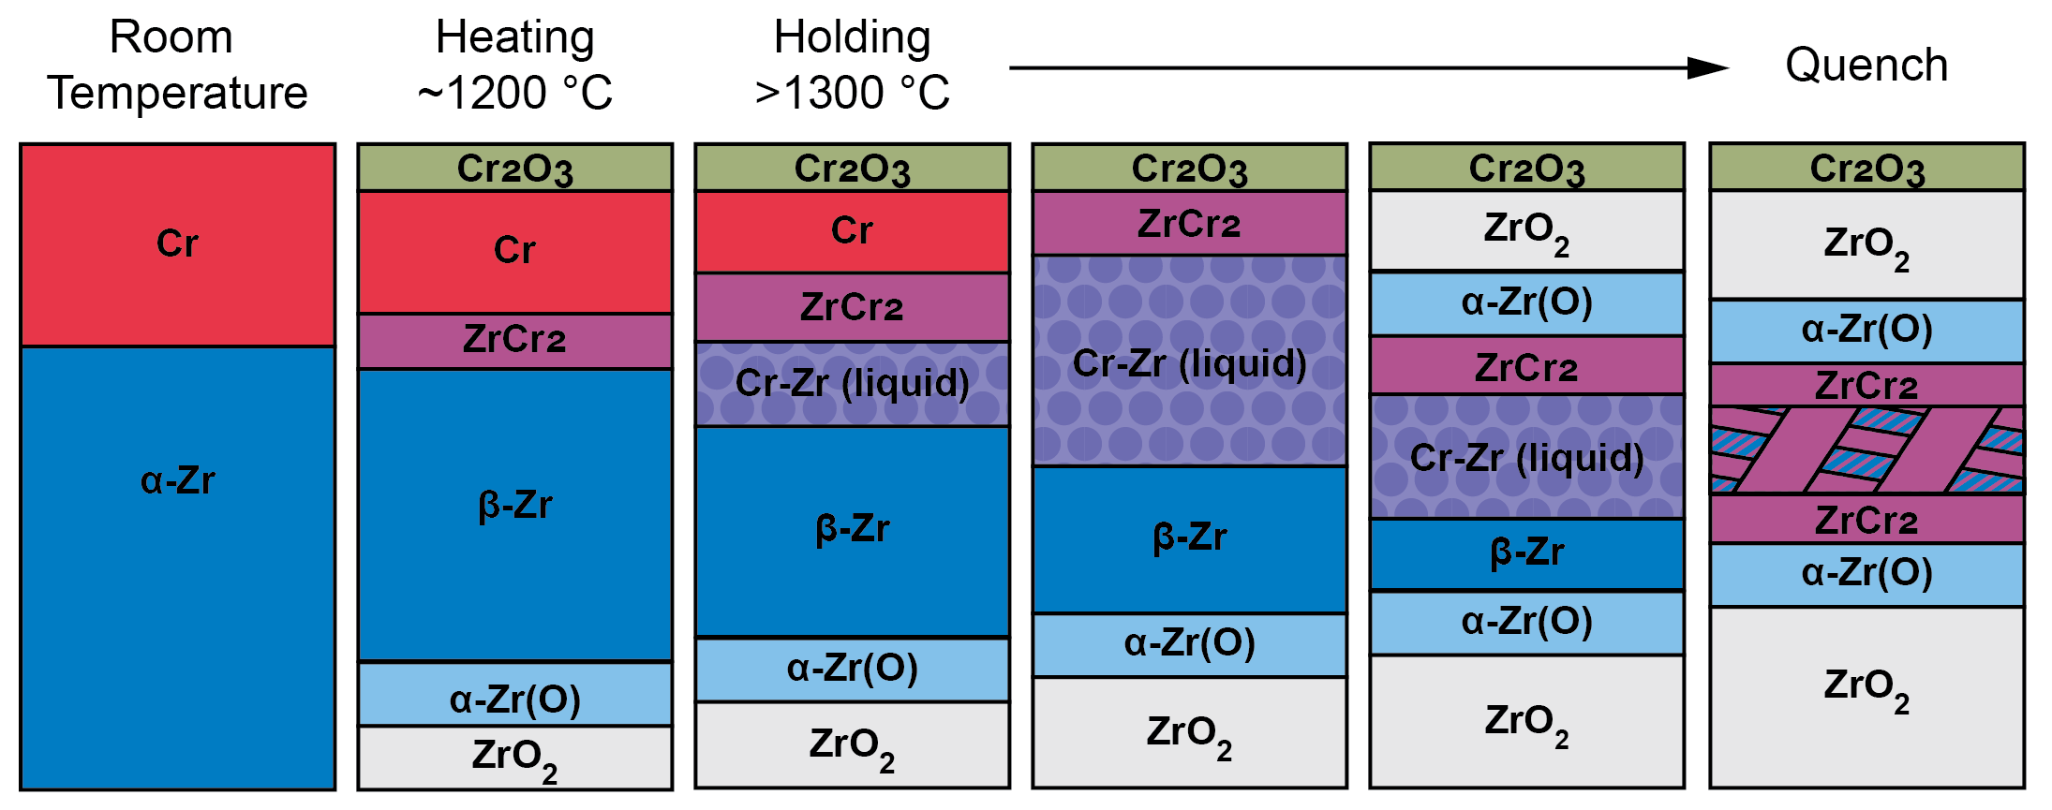
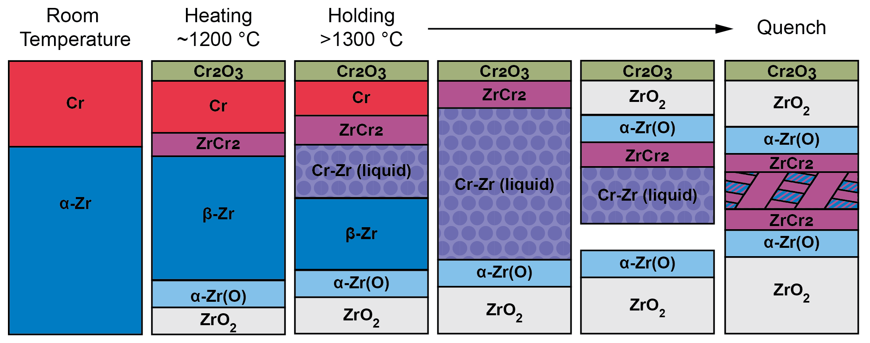
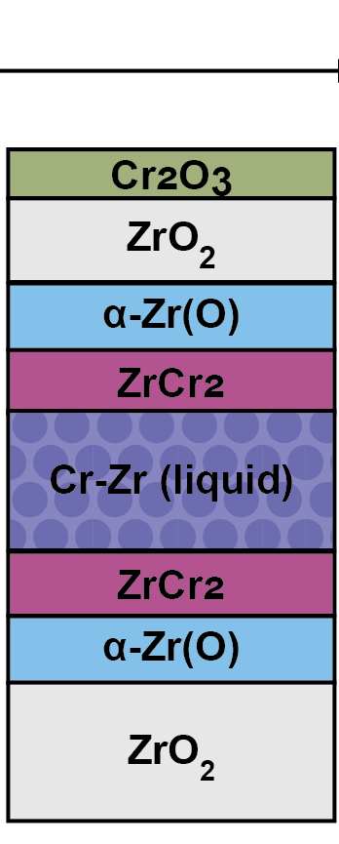
Evolution of Microstructure of Cr coated Zr at 1425 °C Steam Environment
Phase evolution of Cr-coated Zr at very high temperature oxidation is much more complicated than uncoated Zr
After 1425 °C for 5 min
time
1425 °C
Formation of Cr₂O₃, ZrCr₂, Cr/Zr solid solution
Cr-Zr eutectic melting at the solid solution
Zr & Cr consumed by liquid
Zr preferentially oxidized in ZrCr₂ and Zr/Cr liquid, pushing the ZrCr₂ front inwards, resulting in ZrO₂ and Zr(O) under Cr₂O₃
Cr/Zr solution
(1)
(2)
(3)
(4)

Slide 15
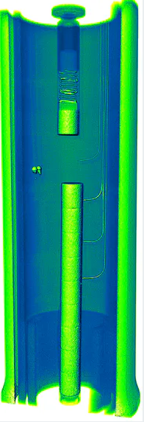
Material Characterization and Mechanical Test after TREAT Testing
Non-destructive neutron radiography
  Fuel relocation, void formation, pellet cracking, and fuel melting
Visual inspection
  Visible defect or failures (coating delamination, ballooning strain, burst opening size)
Mechanical tests
  3-point bend test, ring compression test
Microstructural analysis
  SEM fractography
  Cross-sectional optical microscopy and SEM
  Electron Probe Microanalysis (EPMA)
3D neutron computed tomography of TREAT Test capsule [INL]

Slide 16
PIE Test Matrix

Slide 17
Analysis and Modeling of Failure Mechanism of Cr-coated Cladding
Integration of the experimental data, interpretation, and documentation
Development of swelling and burst model
Clad-to-coolant heat transfer characteristics and modeling of rewetting phenomena
Initial modeling work will be performed for uncoated Zr-alloy cladding tube using a rich database
The experimental findings will be incorporated into the BISON fuel performance code

Slide 18
Project Schedule
The project will be carried out over a four-year period, including sample preparation, shipping, transient irradiation vehicle construction, transient irradiation, and post-irradiation examination and testing
Project Technical Task | Year 1 |  |  |  | Year 2 |  |  |  | Year 3 |  |  |  | Year 4
 | Q1 | Q2 | Q3 | Q4 | Q1 | Q2 | Q3 | Q4 | Q1 | Q2 | Q3 | Q4 | Q1 | Q2 | Q3 | Q4
Cr-coated cladding fabrication
Transient irradiation tests
Neutron radiography and visual inspection
Mechanical tests
SEM fractography
Microstructural analysis
Data analysis and modeling
Year 1 annual report |  |  |  | ×
Year 2 annual report |  |  |  |  |  |  |  | ×
Year 3 annual report |  |  |  |  |  |  |  |  |  |  |  | ×
Year 4 annual and final report |  |  |  |  |  |  |  |  |  |  |  |  |  |  |  | ×

Slide 19
Concluding Remarks
Responses of Cr-coated Zr-alloy claddings under prototypical Reactivity- Initiated Accident (RIA) conditions in comparison with uncoated Zr-alloy cladding will be investigated
Cr coatings deposited by cold spray process and PVD process, adopted by Westinghouse Electric Company and Framatome will be produced at UW and UIUC and then tested in TREAT facility
The results of the project will be used for anticipated licensing applications to NRC, thereby accelerating deployment of Cr-coated ATF concepts in U.S. commercial power reactors

Slide 20
Questions?

