Slide 1
Rapid Turnaround Experiments
Nuclear Science User Facilities
Jeff Benson
Rapid Turnaround Experiments Administrator
NSUF Annual Review November 9-10, 2020
INL/MIS-20-00723

Slide 2
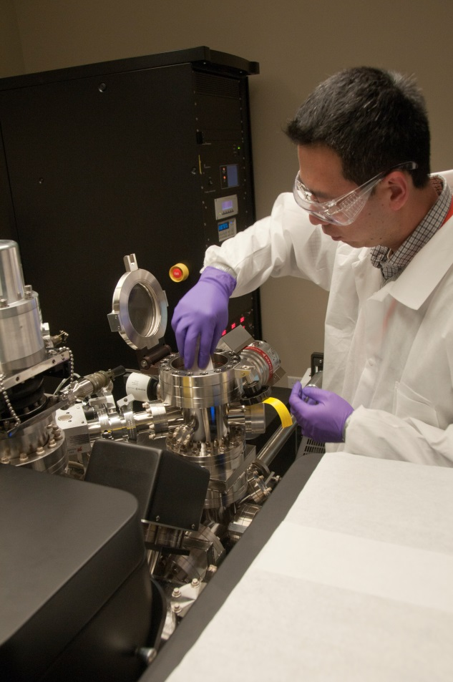
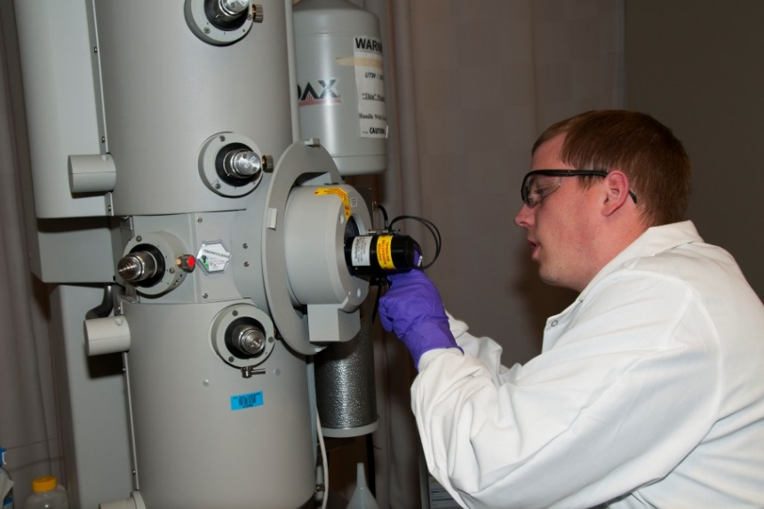
NSUF RTE Overview
Rapid Turnaround Experiments (RTEs) offer researchers the opportunity to perform irradiation effects studies of limited scope on a small number of samples. Completion of RTE projects is expected within 9 months of award. Irradiation experiments that require use of the ATR, MITR, TREAT or HFIR reactors do not qualify as rapid turnaround experiments.
RTE solicitations are typically on a four-month cycle from the opening of the call to announcement of awards.

Slide 3
FY 2020 RTE Calls
2019
1st Call
2020
2nd Call
This Photo by Unknown Author is licensed under CC BY-NC

Slide 4
NSUF RTE Proposal Review
Rapid Turnaround Experiments (RTEs) receive three different reviews
All rapid turnaround experiment proposals are reviewed for feasibility, program relevance and scientific merit.
NSUF makes every effort to match reviewers' expertise to the proposal's research areas. Proposals are scored on scientific merit (50%), technical feasibility (30%), and capability of the group (20%).
Brenden Heidrich (NSUF) and Simon Pimblot (NSUF) and Tansel Selekler (DOE) perform the relevance reviews.
Proposals are also reviewed for feasibility at INL and partner facilities.

Slide 5
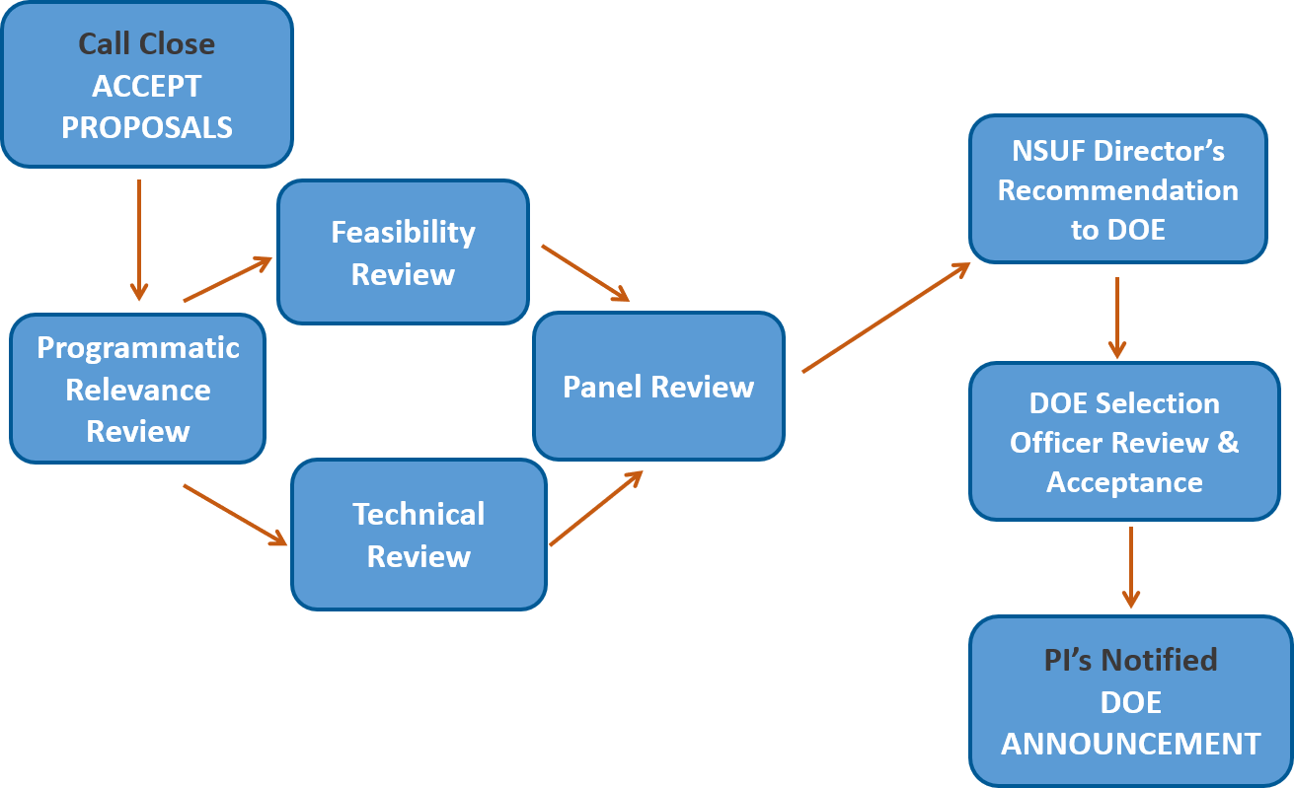
RTE Solicitation Review Process

Slide 6
RTE Proposals/Awards

Slide 7
Facility Requests

Slide 8
NSUF RTE Growth
168 Submittals from 44 institutions
27 U.S. Universities
California Polytechnic State University
Clemson University
Idaho State University
Massachusetts Institute of Technology
Missouri Science and Technology
North Carolina State University
Oregon State University
Purdue University
Rensselaer Polytechnic Institute
Stanford University
Stony Brook University
Texas A&M University
The Ohio State University
University of Alabama
University of California- Los Angles
University of California-Berkeley
University of California-Irvine
University of Florida
University of Idaho
University of Illinois
University of Michigan
University of Nebraska
University of New Mexico
University of North Texas
University of Tennessee-Knoxville
University of Wisconsin
Virginia Tech
6 Foreign Institutions
9 National Laboratories
2 Industrial Organizations
Argonne National Laboratory Brookhaven National Laboratory
Idaho National Laboratory
Lawrence Livermore National Laboratory
Los Alamos National Laboratory
NASA Langley Research Center
Oak Ridge National Laboratory
Sandia National Laboratory
Fermi National Accelerator Laboratory
Canadian Nuclear Laboratories
University of Leoben
Nagoya University
Queen's University
University of Huddersfield
University of Oxford
General Electric Global Research
Radiation Effects Consulting
Proposals
Awards

Slide 9
Submitted Proposal Institution Type

Slide 10
FY 20 Award by Institution Type

Slide 11
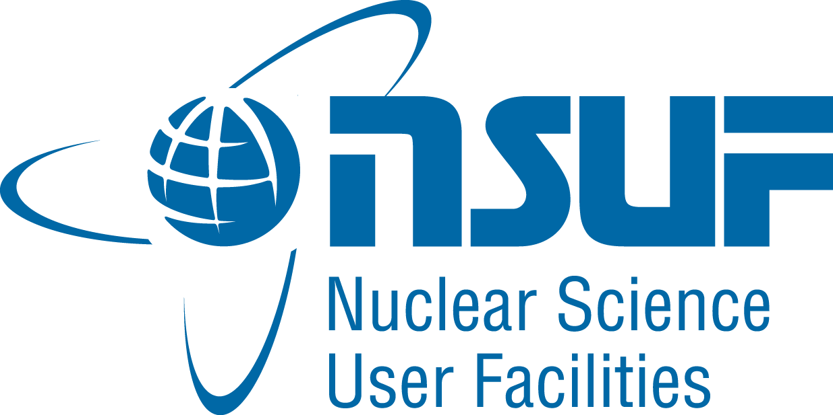
Contact Information
Jeff Benson
(208) 526-3841
Jeff.Benson@INL.gov

